Slide 1

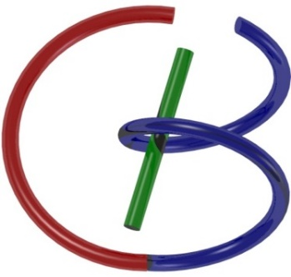
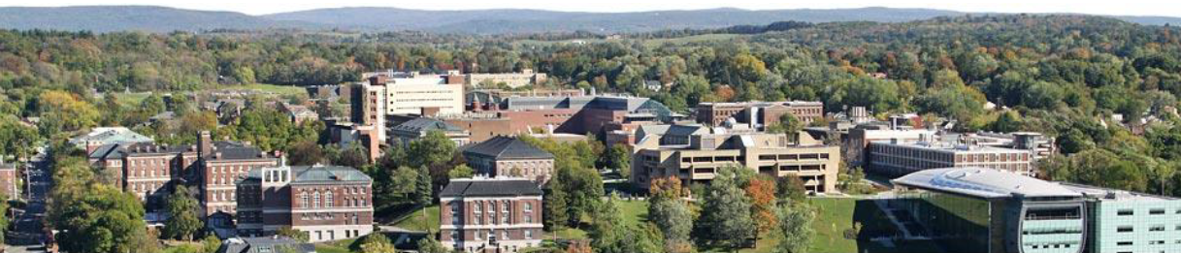
Multimodality Imaging
Ge Wang
AI-based X-ray Imaging System (AXIS) Lab
Rensselaer Polytechnic Institute, Troy, New York, USA
November 19, 2021

Slide 2
MI Schedule for F21
Tue | Topic | Fri | Topic
08/31 | Introduction | 09/03 | Neuron, Network & Backpropagation
09/07 | No Class | 09/10 | Hands-on 1: Python, Colab, & TensorF
09/14 | Architectures & Training | 09/19 | Hands-on 2: MNIST Classification
09/21 | Image Quality I | 09/24 | CT Physics
09/28 | CT Reconstruction | 10/01 | Deep CT Reconstruction
10/05 | Hands-on 3: CT Networks | 10/08 | More CT Contents
10/12 | MRI Physics | 10/15 | Spin-Echo
10/19 | K-Space Theorem | 10/22 | More MRI Contents
10/26 | Mid Exam | 10/29 | Deep MRI Reconstruction
11/02 | Hands-on 4: MRI Networks | 11/05 | Nuclear Physics
11/09 | Nuclear Imaging | 11/12 | US Imaging
11/16 | Optical Imaging | 11/19 | Multimodality Imaging
11/23 | Hands-on 5: Image Conversion | 11/26 | Thanksgiving
11/30 | Image Quality II | 12/03 | Stability, Interpretability, & Others
12/07 | Overview | 12/10 | Final Exam
Office Hour: Teaching Day 5-6pm: https://rensselaer.webex.com/meet/wangg6

Slide 3
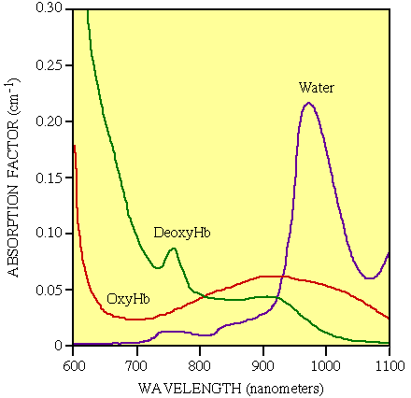
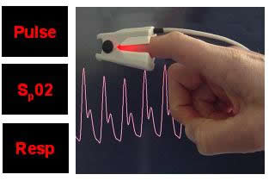
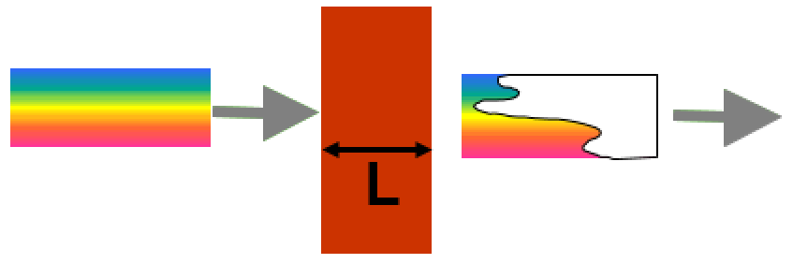
Diffuse Optical Spectroscopy (DOS)
Hemoglobin Concentration
Oxygen Saturation
I(λ) = I₀(λ)exp(-μ_{a}L)

Slide 4
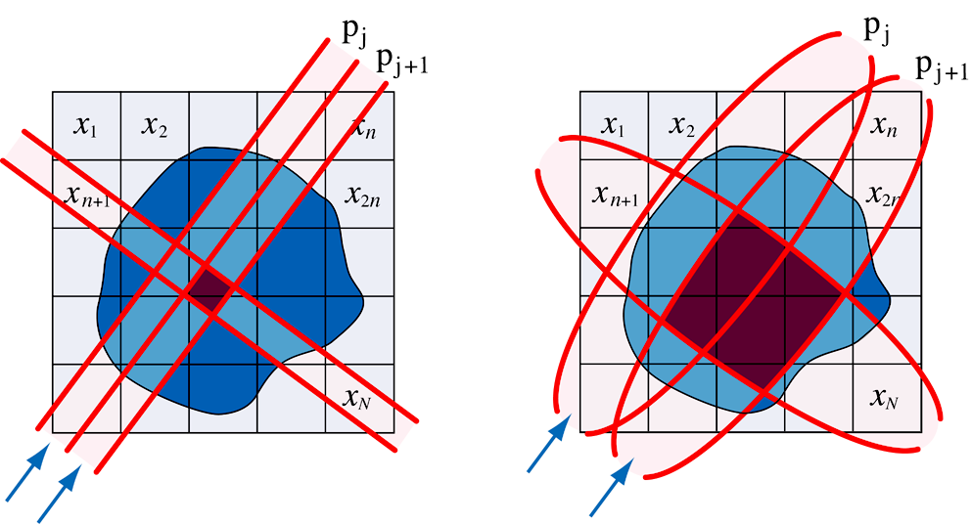
Diffuse Optical Tomography (DOT)
CT
DOT
X. Intes, V. Ntziachristos, J. Culver, et al., Phys. Med. Biol., 47:N1 (1998)

Slide 5
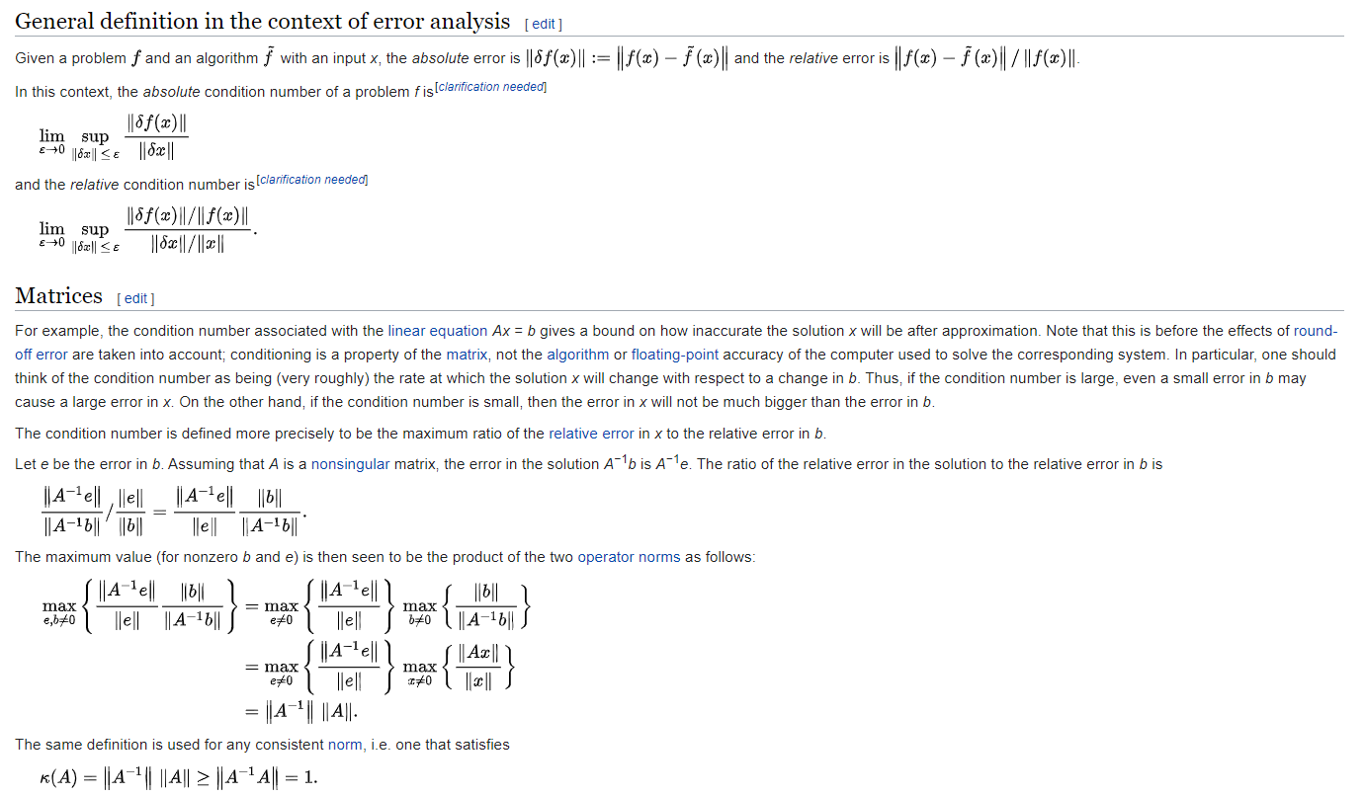
Condition Number

Slide 6
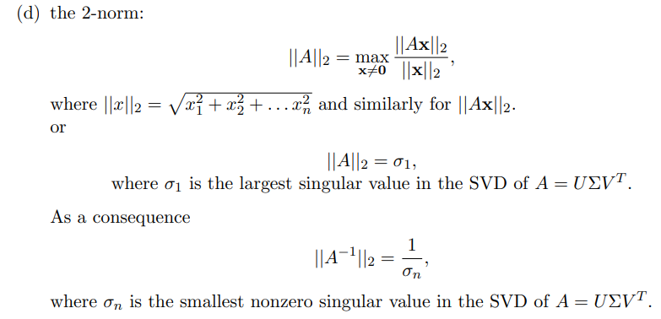
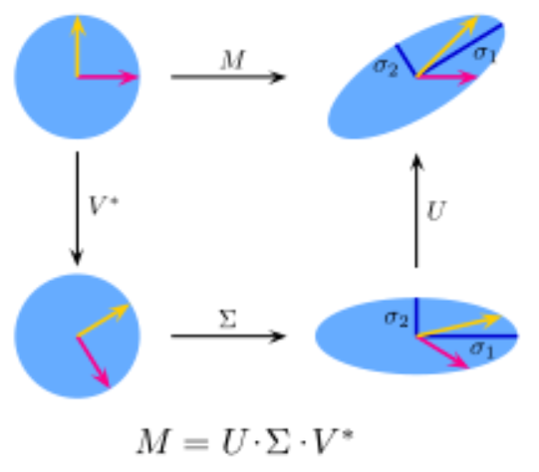
Matrix Norm
http://faculty.nps.edu/rgera/ma3042/2009/ch7.4.pdf

Slide 7
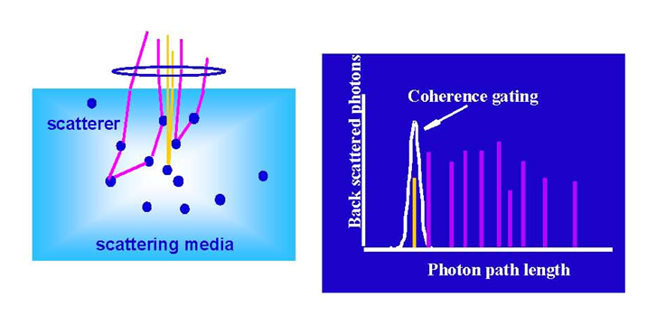
Temporal Gating

Slide 8
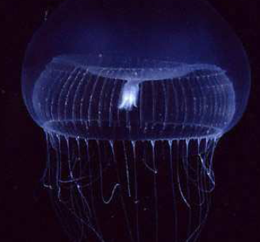
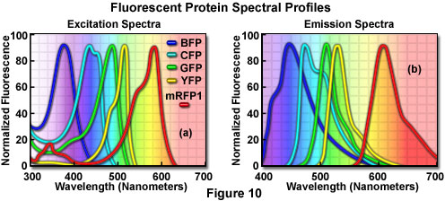
Fluorescence Emission
Endogenous-Exogenous fluorophores
Green fluorescent protein from photogenic cells of jellyfish
Not naturally expressed in cells
Aequorea Victoria

Slide 9
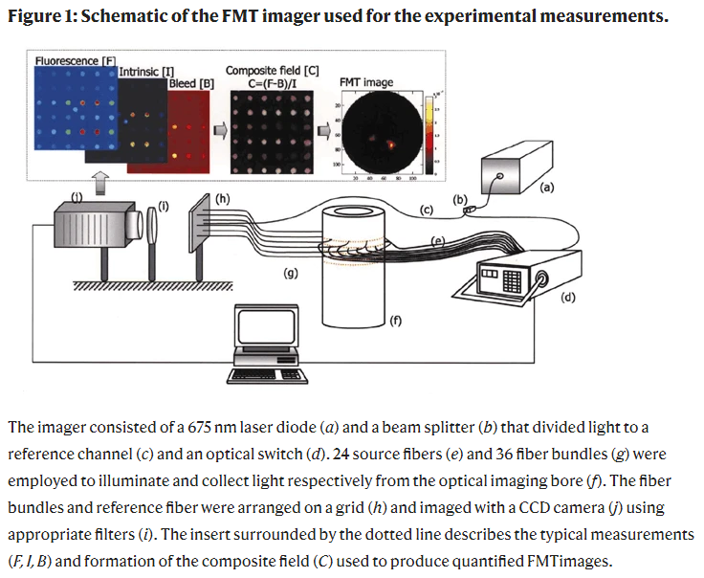
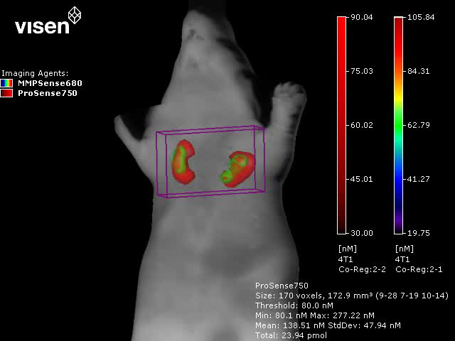
Fluorescence Molecular Tomography
https://www.nature.com/articles/nm729

Slide 10
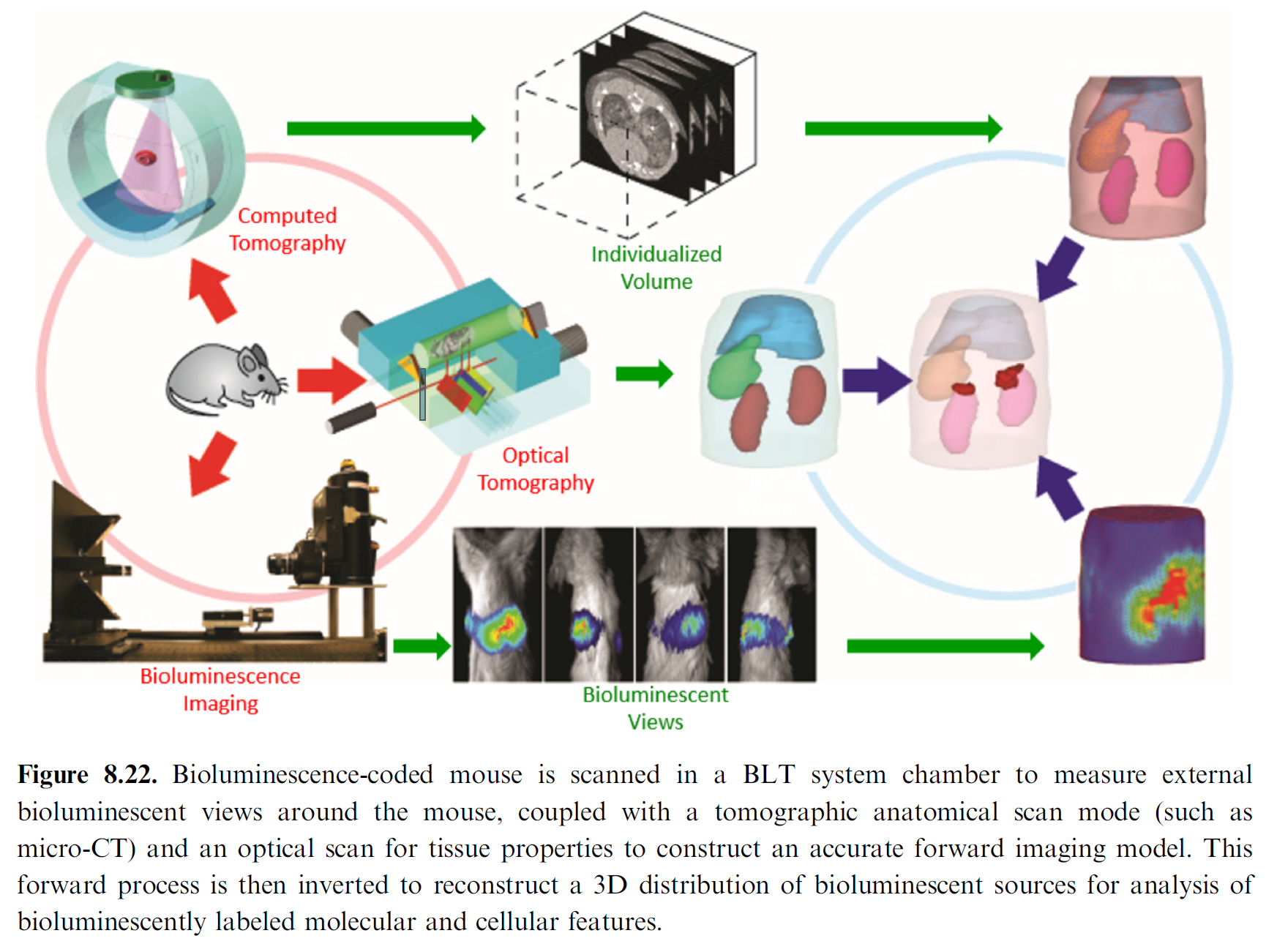
Bioluminescence Tomography

Slide 11
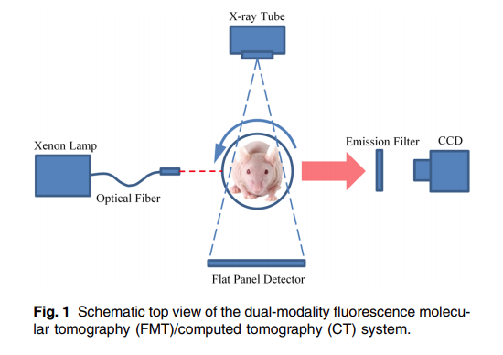
Fluorescence Tomography
J. of Biomedical Optics, 20(5), 055004 (2015). https://doi.org/10.1117/1.JBO.20.5.055004

Slide 12
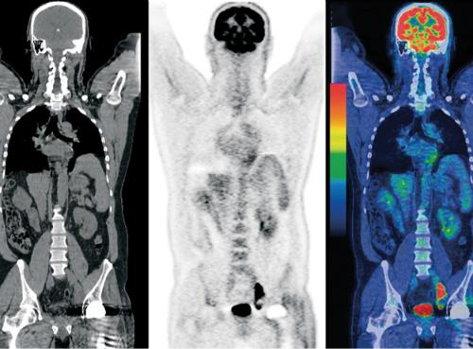
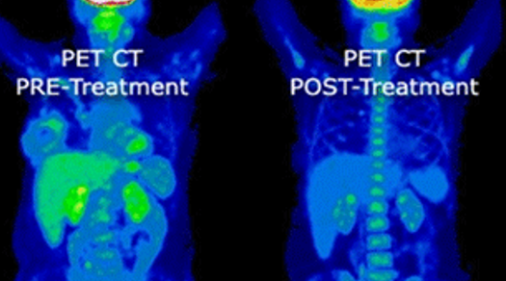
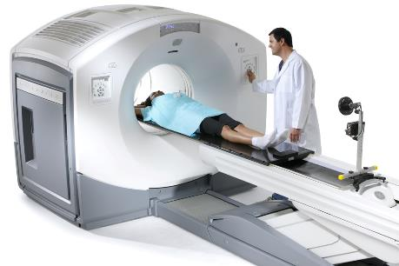
PET-CT
Correct attenuation
Pinpoint cancers
Monitor therapies

Slide 13
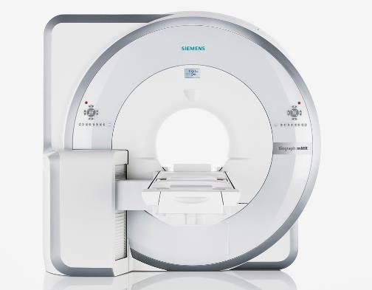
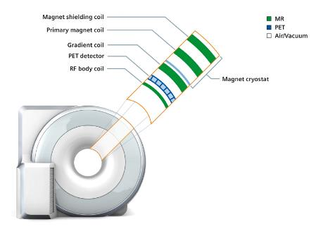
PET-MRI
Unrestricted © Siemens AG 2014
All rights reserved

Slide 14
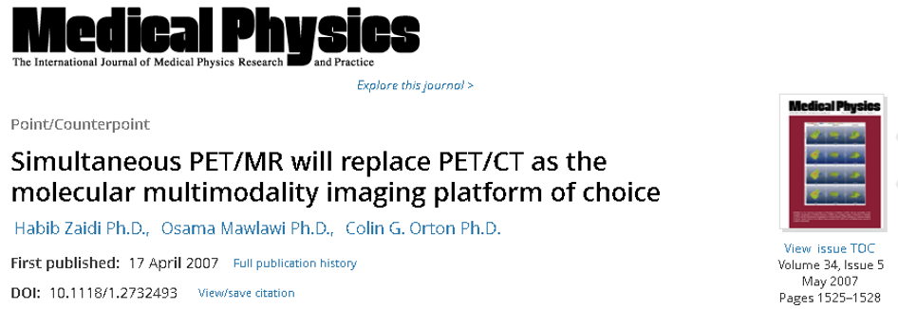
PET-MRI: Point/Counterpoint
Identical physiology
Motion suppression
Soft tissue contrast
No radiation
Rich functional info
Expensive
Slow speed
Compromised attenuation correction
Unclear killer utility

Slide 15

CT
PET/SPECT-CT
CT-MRI
PET/SPECT
MRI
PET/SPECT-MRI

Slide 16

MRI-CT: Cardiac Imaging
State-of-the-Art CT
Pros
Fast scanning speed
Adequate resolution
Cost-effective
Widely available
Easily maintained
Cons
Difficulty with high/irregular rates
Inability to measure flow & separate
calcium from iodine signals
(calcified coronary)
Need for agents in microvasculature
Myocardial perfusion with stress
to be FDA-approved
Radiation dose
State-of-the-Art MRI
Pros
Excellent soft tissue contrast
Functional/flow, molecular imaging
Myocardial perfusion evaluation
Infants/children with
congenital heart diseases
No radiation dose
Cons
Very long exam time
Coronaries difficult to visualize
Metal & other restrictions
(pacemaker, anesthesia, etc.)
Slow speed at high cost
Need for fast coils, special
acquisition & processing
Notes:
The most demanding imaging applications are cardiovascular. If you look at “top of the line” CT scanners, they are all built to meet CV requirements. Despite this, they have important limitations.
The most important parts of CVMR are to visualize flow without contrast agents, assess myocardial viability with late gadolinium enhancement, and depict valvular diseases.

Slide 17
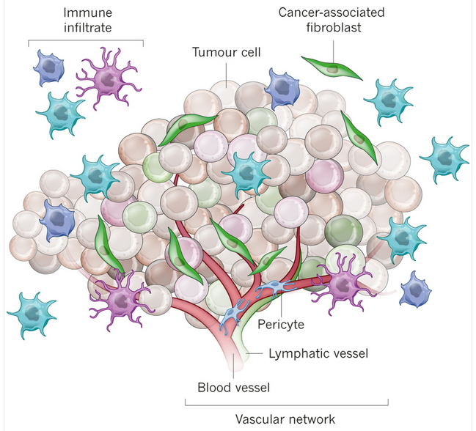
CT-MRI: Cancer Imaging
Influence of Tumour Micro-environment Heterogeneity on Therapeutic Response. Nature 501:346, 2013

Slide 18
Dynamic Contrast Enhancement
Numerous DCE with CT or MRI Studies
8,436 journal papers on Web of Science
Modality-specific variability
~20% variability for CT or MRI
Inter-modality difference
>40% CT-MRI difference in cancer rat studies
Technol Cancer Res T 11:279, 2012

Slide 19
Technical Feasibility
Space Limitation
Permitted by Interiorized CT & Interiorized MRI/Low-field MRI
Electromagnetic Interference
Avoided with Stationary CT, EM Shielding,
& Lower Peripheral Magnetic Field
Data Incompleteness
Addressed via Feature Correlation Across Modalities
& Deep Learning

Slide 20
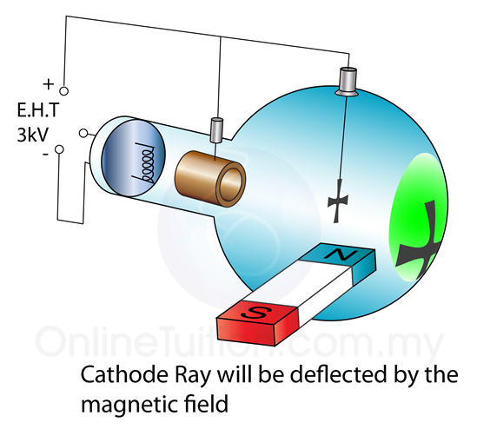
Major Obstacles
Magnetic Field May
Damage the Motor in the X-ray Tube
Deflect the E-beam to the Anode Target
Deteriorate Data Quality of the X-ray Detector
Ferromagnetic X-ray Components May Disrupt the Magnetic Field

Slide 21
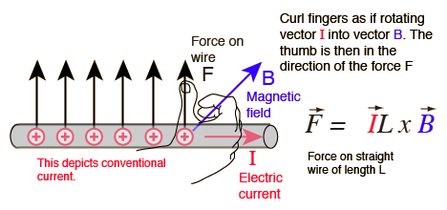
X-ray Tube in a Magnetic Field

Slide 22
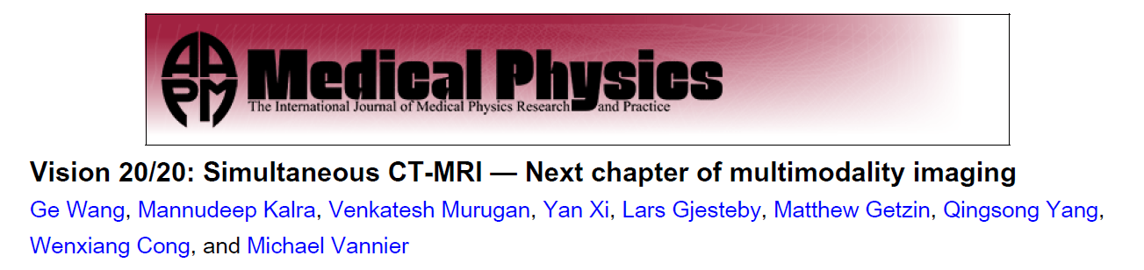
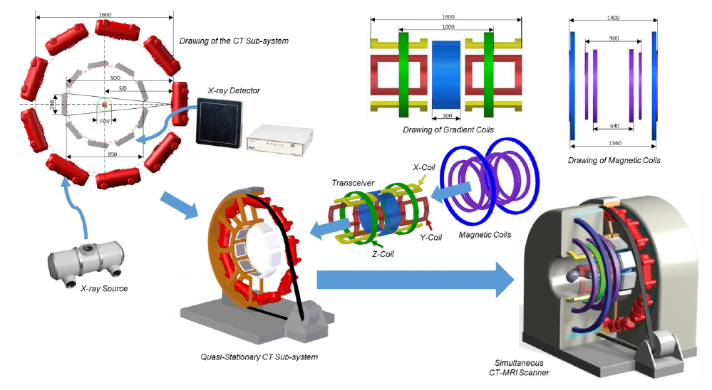

Slide 23
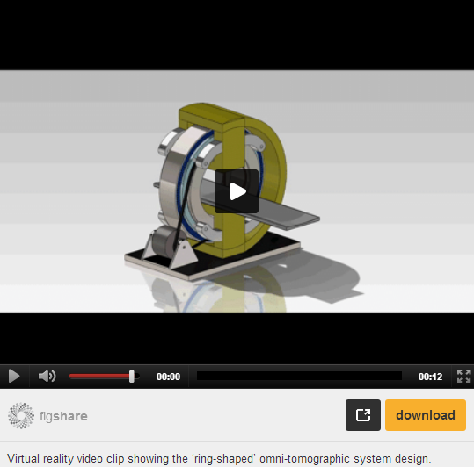
Omni-tomography
http://www.plosone.org/article/info%3Adoi%2F10.1371%2Fjournal.pone.0039700#s5

Slide 24
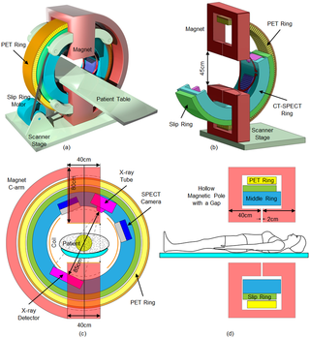

Slide 25
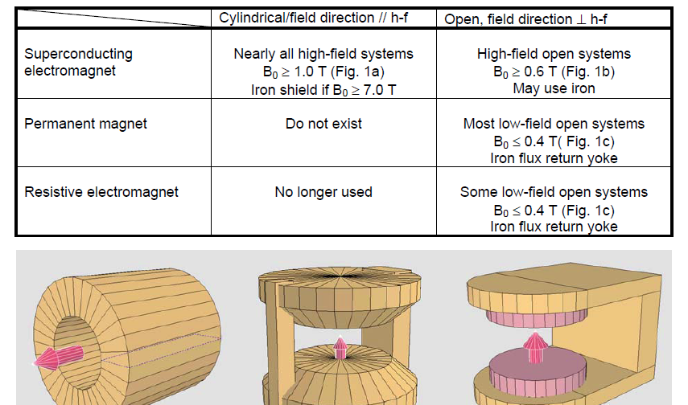
Static Magnetic Field

Slide 26
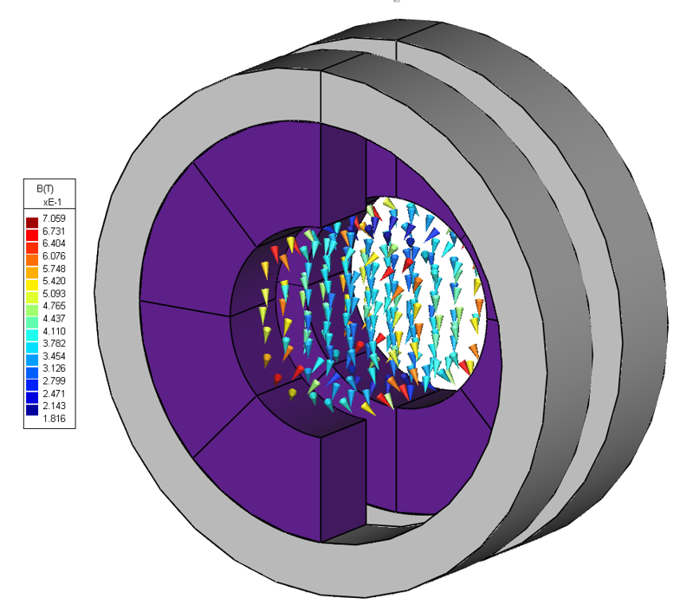
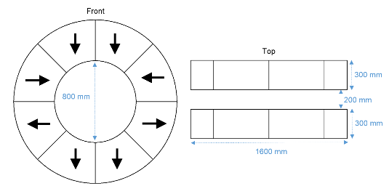
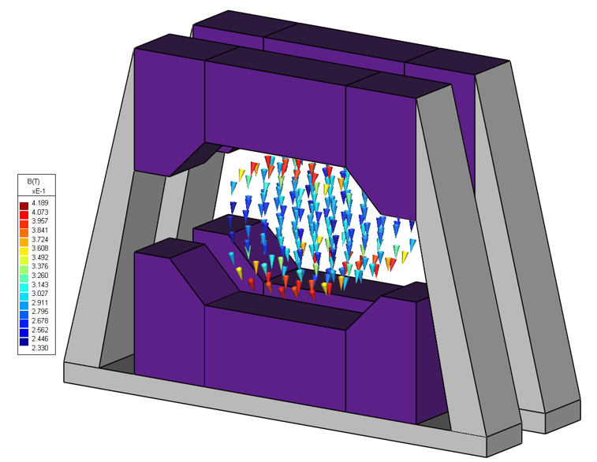
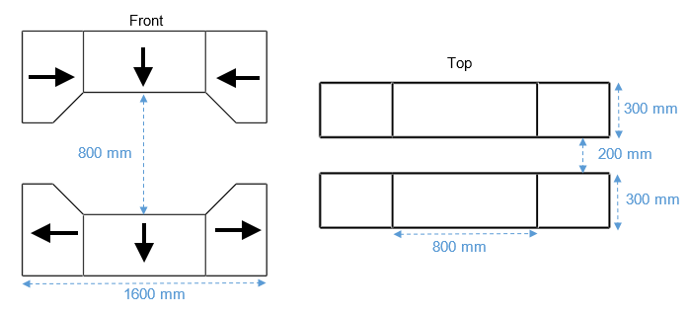
Heuristic Design

Slide 27
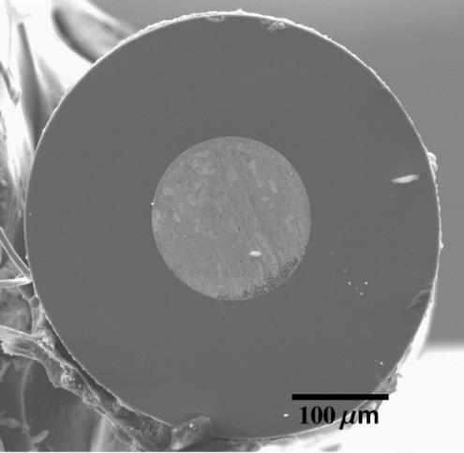
Superconducting Fibers
D. Homa, et al., Appl. Phys. Lett., 103.82601 (2013):1–4.
D. Homa, et al., Cryogenics (Guildf)., 61 (2014):25–30.
Notes:
These fibers are made with an iron core and fused silica cladding. This emerging technology is capable of exhibiting superconductivity for an extended period of time after injection with liquid helium. The fiber can be wound into coils to achieve a homogeneous main magnetic field with less power consumption.

Slide 28
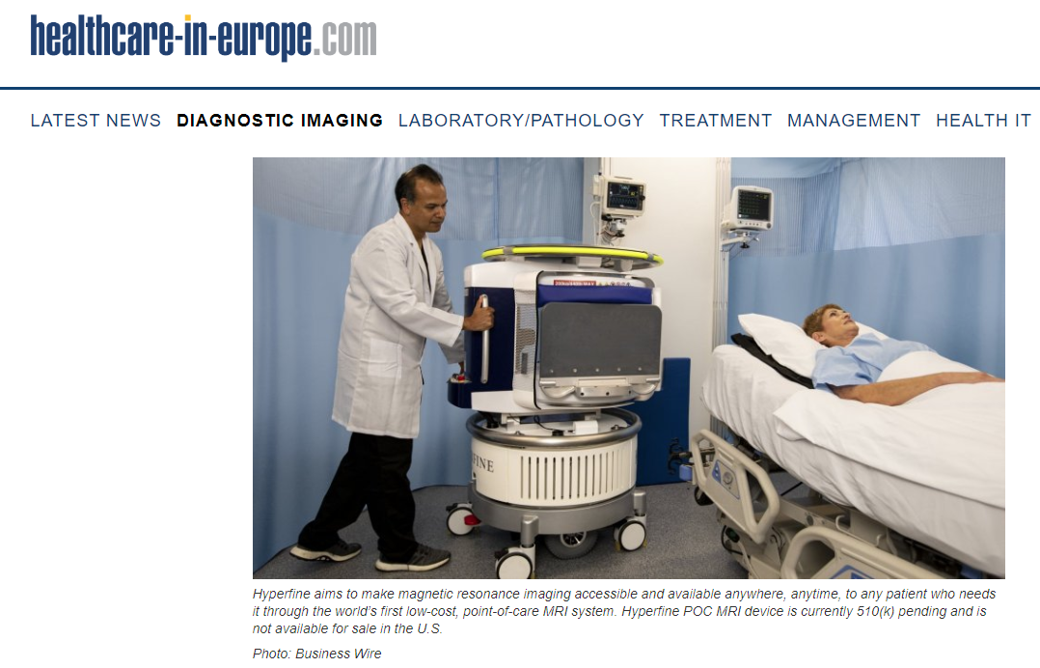

Slide 29
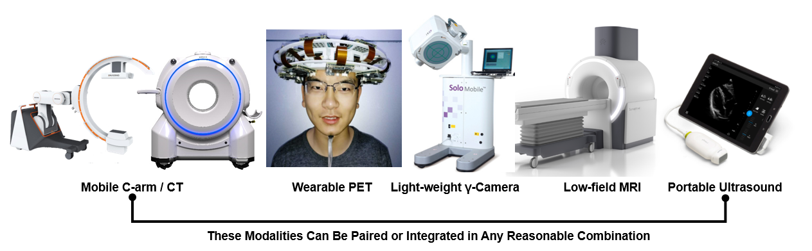
Point of Care Imaging
Wang G, Ye JC, De Man B: Deep learning for tomographic image reconstruction. Nature Machine Intelligence, 2020

Slide 30
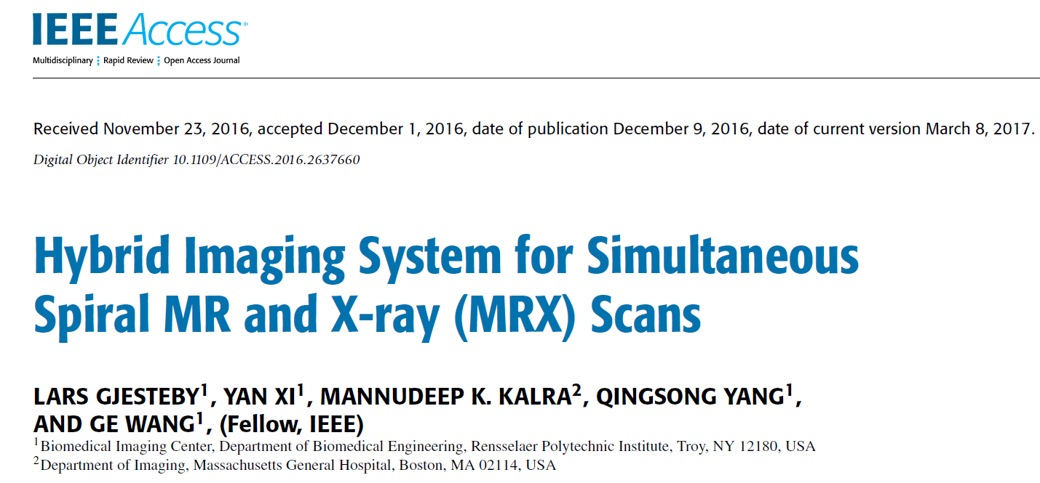
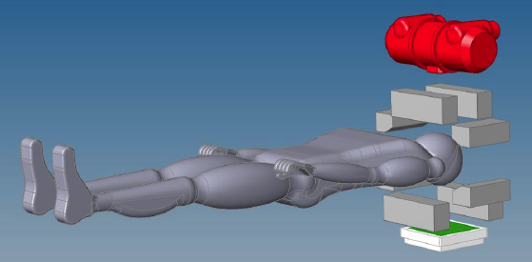
Double-Helix CT-MRI Scanning

Slide 31
PET/SPECT
PET/SPECT
PET-CT
SPECT-CT
PET-MRI
CT
MRI
PET-CT
SPECT-CT
PET-MRI
Omni-tomography:
PET-CT-MRI
CT-MRI
LINAC
CT-LINAC
MRI-LINAC
CT
CT-MRI-LINAC
MRI
CT-LINAC
MRI-LINAC
LINAC
Multi-modality Imaging
– From Present to Future of Grand Fusion

Slide 32
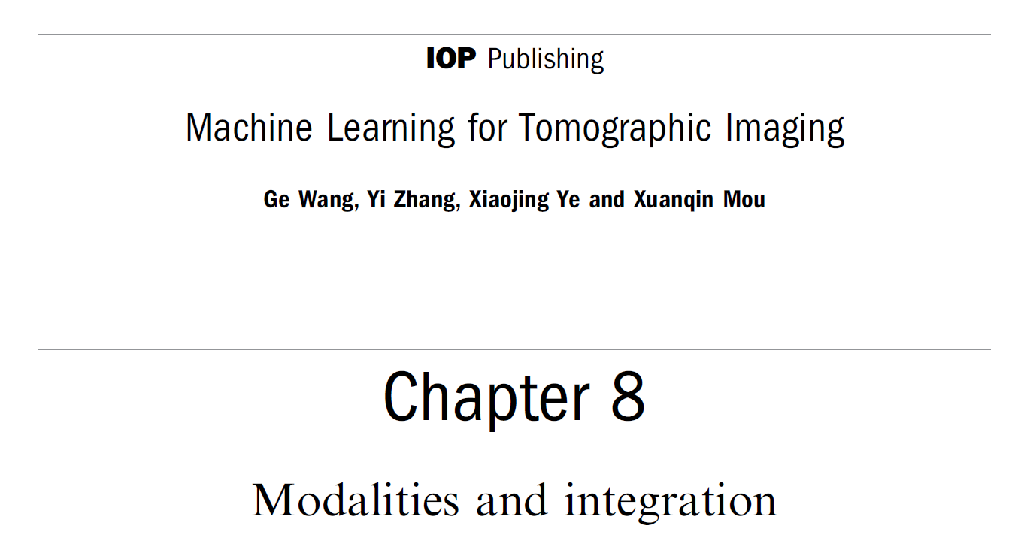
Homework
1) Simultaneous CT-MRI (Optional)
2) Omni-tomography (Optional)
3) Read my SPIE plenary article in the dropbox
3) Green book chapter on integration
4) Hands-on 5 (video, and run the codes)

