Slide 1
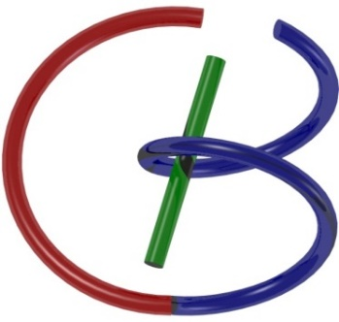
Nuclear Imaging
Ge Wang
AI-based X-ray Imaging System (AXIS) Lab
Rensselaer Polytechnic Institute, Troy, New York, USA
November 9, 2021

Slide 2
MI Schedule for F21
Tue | Topic | Fri | Topic
08/31 | Introduction | 09/03 | Neuron, Network & Backpropagation
09/07 | No Class | 09/10 | Hands-on 1: Python, Colab, & TensorF
09/14 | Architectures & Training | 09/19 | Hands-on 2: MNIST Classification
09/21 | Image Quality I | 09/24 | CT Physics
09/28 | CT Reconstruction | 10/01 | Deep CT Reconstruction
10/05 | Hands-on 3: CT Networks | 10/08 | More CT Contents
10/12 | MRI Physics | 10/15 | Spin-Echo
10/19 | K-Space Theorem | 10/22 | More MRI Contents
10/26 | Mid Exam | 10/29 | Deep MRI Reconstruction
11/02 | Hands-on 4: MRI Networks | 11/05 | Nuclear Physics
11/09 | Nuclear Imaging | 11/12 | US Imaging
11/16 | Optical Imaging | 11/19 | Multimodality Imaging
11/23 | Hands-on 5: Image Conversion | 11/26 | Thanksgiving
11/30 | Image Quality II | 12/03 | Stability, Interpretability, & Others
12/07 | Overview | 12/10 | Final Exam
Office Hour: Teaching Day 5-6pm: https://rensselaer.webex.com/meet/wangg6

Slide 3
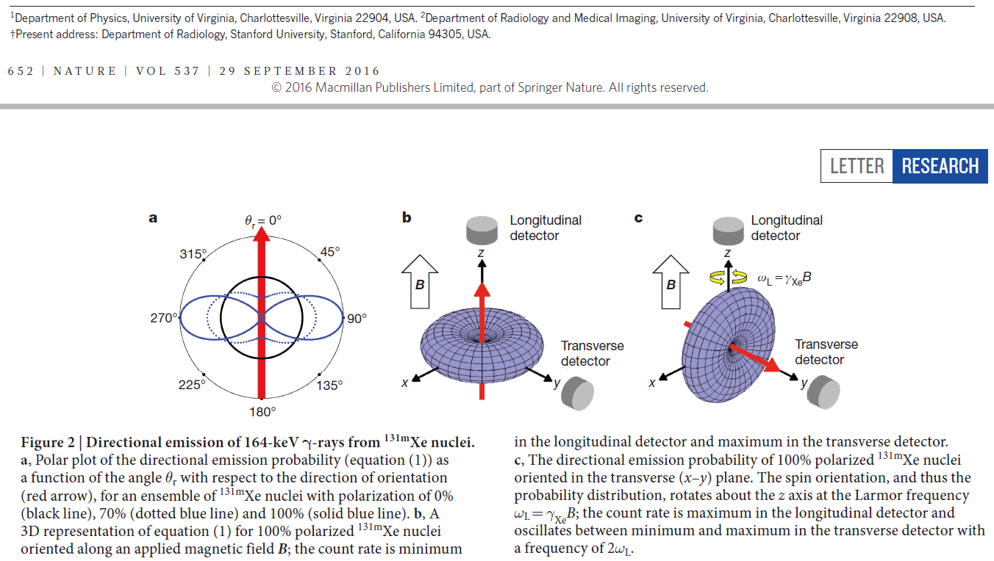
Polarization & Manipulation

Slide 4
Existing Polarizable Tracers
Characteristics of some radioisotopes that are the best known candidates for SET at this time. However, these would not be practical for clinical imaging.
Isotope | Half-life | Spin number | γ-ray Emission (keV) | γ-ray Branching Ratio
^{131m}Xe | 12 days | 11/2 | 164 | 2%
^{127m}Xe | 69 sec | 9/2 | 124.8-172.5 | 38%
^{79m}Kr | 50 sec | 7/2 | 130 | 27%

Slide 5
Preferred Properties of Tracers
Polarity: 60-90%
Half-life of Radioactivity: Minutes to Hours
Half-life of Polarity: Minutes to Hours
Biocompatibility: With Possible Surface Modifier
Cost-effectiveness: Comparable to Other Tracers
… …

Slide 6
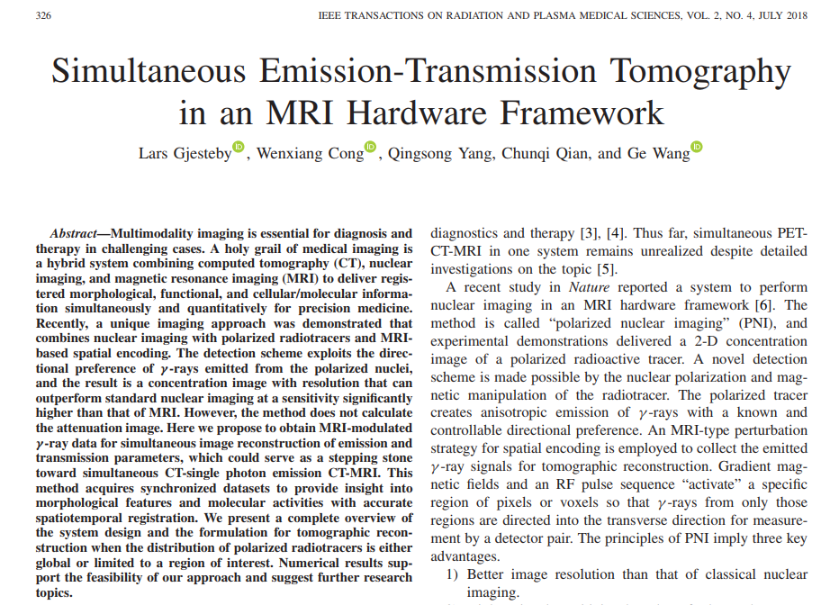
SET Idea

Slide 7
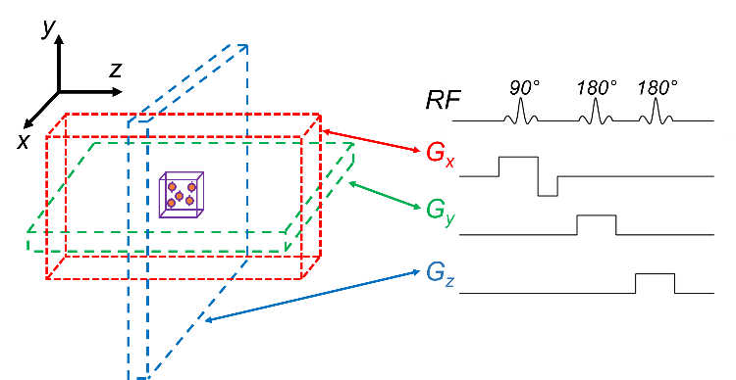
Spin Around

Slide 8
SET Data Model
m₁
m₂
r
At location r
m₁ and m₂: paired data
Φ: γ-ray flux
µ: attenuation coefficient
Linear integral equation permits inverse solution of
Attenuation coefficients
Flux escaping each side of activated location proportional to concentration

Slide 9
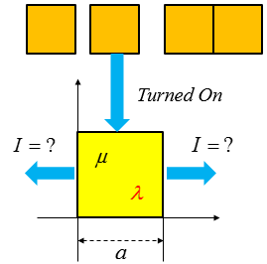
Quiz
If we turn on each pixel at a time and measure data on two sides, can we solve all µ and λ values uniquely?
I: flux
µ: attenuation coefficient
λ: concentration

Slide 10
Full-voxel Activation
Turned On

Slide 11
Half-voxel Activation

Slide 12
Outline
Data Modeling
Statistical Reconstruction
Heuristics

Slide 13
Interaction of γ photons with matter E ~ 60 - 600 keV (e.g. E _{99mTc} = 140 keV)
attenuation is due to Compton scatter and photo-electric absorption
single photon emission:
(μ = linear attenuation coefficient)
example: median of penetration depth for ^{99m}Tc (140 keV) = 4.5 cm
photon pair emission (positron emission):
s=d
s=a
s
s=d₁
γ
γ
s=d₂
s=a
s
the attenuation is identical for each point along the projection line

Slide 14
Fourier reconstruction and filtered backprojection (FBP)
Detected number of photons
SPECT:
PET:
Radon transform:
Not directly applicable due to attenuation !
Solution: transmission scan -> μ -> FBP for PET
s
y
f(x,y)
r
θ
x

Slide 15
Neat Data Models for an Impulse
s=d₁
s=d₂
s=a
s
s=d₁
γ
γ
s=d₂
s=a
s

Slide 16
SPECT Model More Complicated
s=d₁
s=d₂
s=a
s=b
s

Slide 17
Outline
Data Modeling
Statistical Reconstruction
Heuristics

Slide 18
Iterative reconstruction (also for 3D)
Bayesian approach:
Given Λ : reconstructed image Q : measurement (data) Bayes’ rule:
find the maximum a-posteriori probability (MAP)
p(Q) is constant if p(Λ) is assumed constant -> maximum likelihood (ML)

Slide 19
Maximum Likelihood (ML)
Λ = {λ_{j}} -> projections
c_{ij} = sensitivity of detector i for activity j (incl. attenuation)
assume Q = {q_{i}} are samples of a Poisson distribution
-> ->
->
when -> q_{i}! is constant

Slide 20
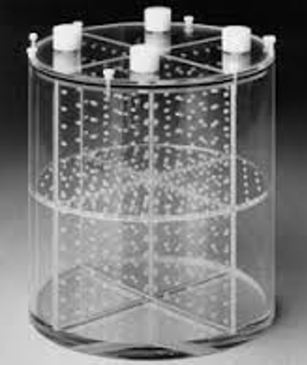
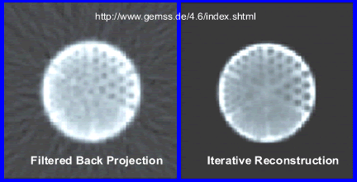
Iterative solution: ML-EM algorithm
->
-> use iterative optimization : expectation-maximization (EM)
FBP
iterative reconstruction

Slide 21
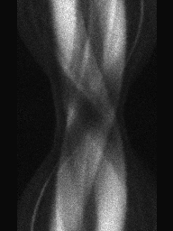
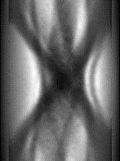
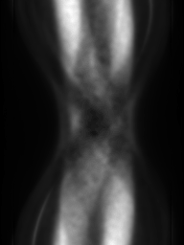
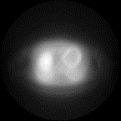
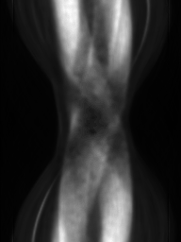
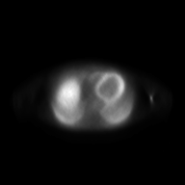
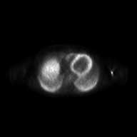
image k
λ_{j} ^{old}
q_{i}
X
image (k+1)
PROJECTIONS
COMPARE
IMAGE
-> correction factor
q_{i}
1
Σ_{i} c_{ij} ( )
Σ_{i} c_{ij}
Σ_{j} c_{ij} λ_{j}^{old}
Σ_{j} c_{ij} λ_{j} ^{old}
REPROJECTION

Slide 22
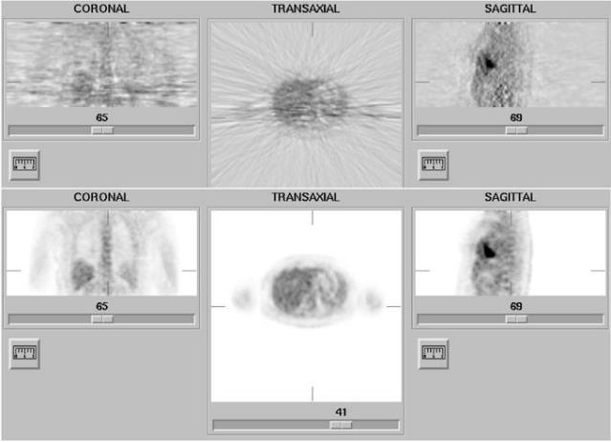
FBP
iterative reconstruction
(34 iterations)

Slide 23
Outline
Data Modeling
Statistical Reconstruction
Heuristics

Slide 24
Heuristics: Sum Game
μ₁=4
μ₂=3
μ₃=2
μ₄=1

Slide 25
Let Us Guess
6
4
Error
0
0
4
3
3
2
Guess 1
0
0
2
1
3
2
Guess 0
4
3
2
Guess 2
Update a guess based on data differences
−2
Error
2
1

Slide 26
Same Game
_{μ1=4}
_{μ2=3}
_{μ3=2}
_{μ4=1}

Slide 27
Ratio instead of Difference
₃
₂
_{Ratio}
₁
₁
₄
₃
₃
₂
_{Guess 1}
₁
₁
₂
₁
₃
₂
_{Guess 0}
_{4.2}
_{2.8}
_{7/5}
_{Guess 2}
_{Update a guess} _{based on} _{data differences}
_{3/5}
_{1.8}
_{1.2}
_{Ratio}

Slide 28
Weighted Sum
_{μ1=4}
_{μ2=3}
_{μ3=2}
_{μ4=1}

Slide 29
Simultaneous Correction
_{Guess}
_{Truth}
_{4/3}
_{Ratio}
_{Ratio}
₁
₁
₄
₃
_{10/3}
_{Guess 1}
₁
₁
₂
₁
_{Guess 0}
Correction Factor = (0.2*10/3+0.1*4/3)/(0.2+0.1)

Slide 30
image k
λ_{j} ^{old}
q_{i}
X
image (k+1)
PROJECTIONS
COMPARE
IMAGE
-> correction factor
q_{i}
1
Σ_{i} c_{ij} ( )
Σ_{i} c_{ij}
Σ_{j} c_{ij} λ_{j}^{old}
Σ_{j} c_{ij} λ_{j} ^{old}
REPROJECTION

Slide 31
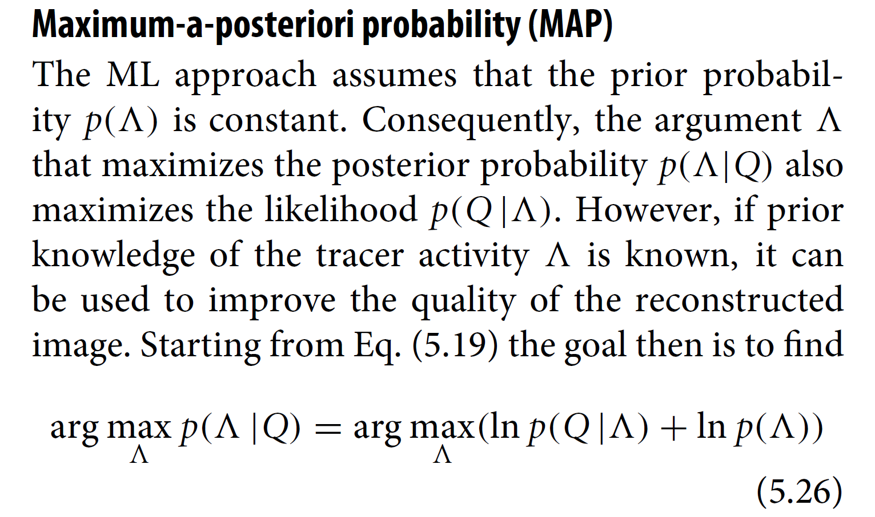
MAP: Regularized Reconstruction

Slide 32
L0 Norm Replaced by L1 Norm
$$\vec{y}=Φ\vec{s}=ΦΨ\vec{x}=A\vec{x}$$
$$Ψ^{−1}\vec{s}=\vec{x}$$
Measurement
Sparsifying
$\vec{s}$= ${Min \atop \vec{s}}$|| $\vec{y}−Φ\vec{s}$||₂+${λ||Ψ}^{−1}\vec{s}||1$
Objective Function consists of two terms:
The first is data fidelity
The second is prior information

Slide 33
Homework
Please compute the correction factors for the rest three pixels, & correct Guess 0, & read my heuristic paper on iterative methods.
_{Guess}
_{Truth}
_{4/3}
_{Ratio}
_{Ratio}
₁
₁
₄
₃
_{10/3}
_{Guess 1}
₁
₁
₂
₁
_{Guess 0}
Correction Factor = (0.2*10/3+0.1*4/3)/(0.2+0.1)

Slide 34
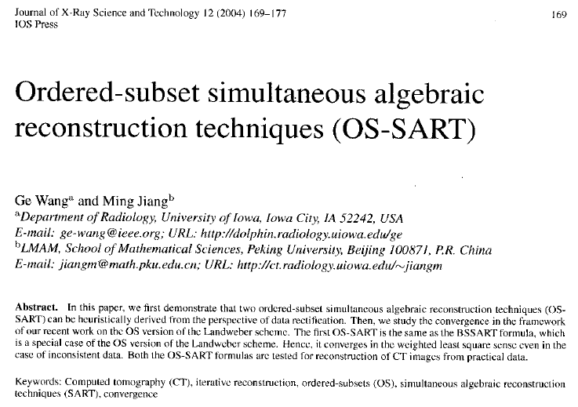
Further Reading (04-Heuristic-SART.pdf)

