Slide 1
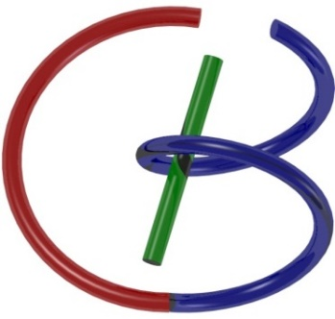
Hands-on 1: Python, Colab, & TensorF
Ge Wang, Huidong Xie, Christopher Wiedeman
AI-based X-ray Imaging System (AXIS) Lab
Rensselaer Polytechnic Institute, Troy, New York, USA
September 10, 2021
Notes:
Hello, since Professor Wang has a conference today out of town, I will give this hands-on introduction based on this PPT we prepared together. As he mentioned last time, we will have deep learning final projects by the end of the semester. Tentatively, we will have five lectures on deep learning hands-on, including this one.

Slide 2
MI Schedule for F21
Tue | Topic | Fri | Topic
08/31 | Introduction | 09/03 | Neuron, Network & Backpropagation
09/07 | No Class | 09/10 | Hands-on 1: Python, Colab, & TensorF
09/14 | Architectures & Training | 09/19 | Hands-on 2: MNIST Classification
09/21 | Image Quality I | 09/24 | CT Physics
09/28 | CT Reconstruction | 10/01 | Deep CT Reconstruction
10/05 | Hands-on 3: CT Networks | 10/08 | More CT Contents
10/12 | MRI Physics | 10/15 | Spin-Echo
10/19 | K-Space Theorem | 10/22 | More MRI Contents
10/26 | Mid Exam | 10/29 | Deep MRI Reconstruction
11/02 | Hands-on 4: MRI Networks | 11/05 | Nuclear Physics
11/09 | Nuclear Imaging | 11/12 | US Imaging
11/16 | Optical Imaging | 11/19 | Multimodality Imaging
11/23 | Hands-on 5: Image Conversion | 11/26 | Thanksgiving
11/30 | Image Quality II | 12/03 | Stability, Interpretability, & Others
12/07 | Overview | 12/10 | Final Exam
Office Hour: Teaching Day 5-6pm: https://rensselaer.webex.com/meet/wangg6

Slide 3
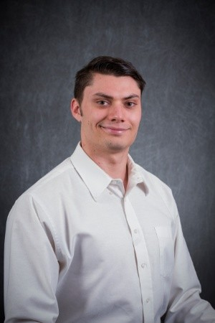
TA: Chris Wiedeman
Advisor: Ge Wang
BS in biomedical engineering (Arizona State University)
Industry experience with ultrasound imaging (Merz North America)
Researcher in AXIS Lab
NSF Fellowship Recipient
wiedec@rpi.edu
He is our volunteer TA. After each of his five hands-on, he will do his office hour on my next teaching day (in blue color) in his WebEx room:
https://rensselaer.webex.com/meet/wiedec,
Tue 3:30-4:30pm and Fri 5-6pm on blue days
If needed, you can email him your questions.

Slide 4
Homework Arrangement
Normally, the last slide in each lecture
Due date is one week later
You can discuss with fellow students
We use “Pass” or “Fail”
Note that mid and final exams will be scored rigorously so that we can reliably distinguish the levels of your proficiency

Slide 5
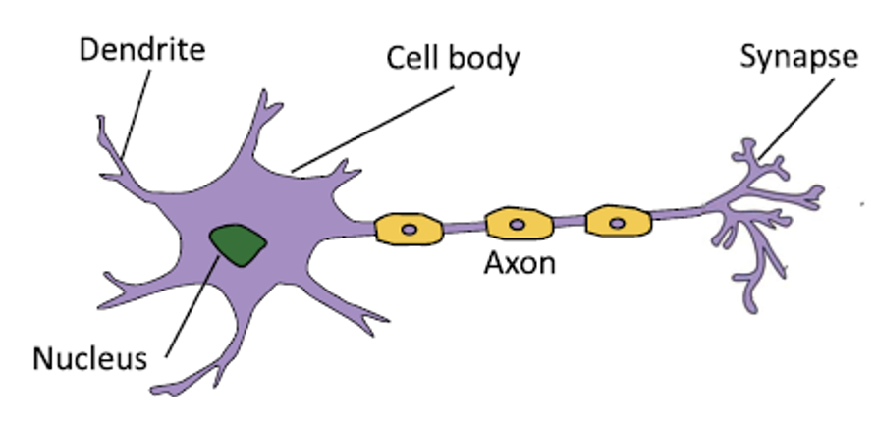
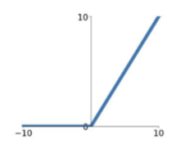
Conventional “Linear” Neuron
Linear
$$x1$$
$$w1$$
Nonlinear
$$w2$$
$$y$$
$$x2$$
…
$$wn$$
Output
$$xn$$
Inner Product
Input
$$y=σ\left(x\right)=ReLU⁡(x)$$

Slide 6
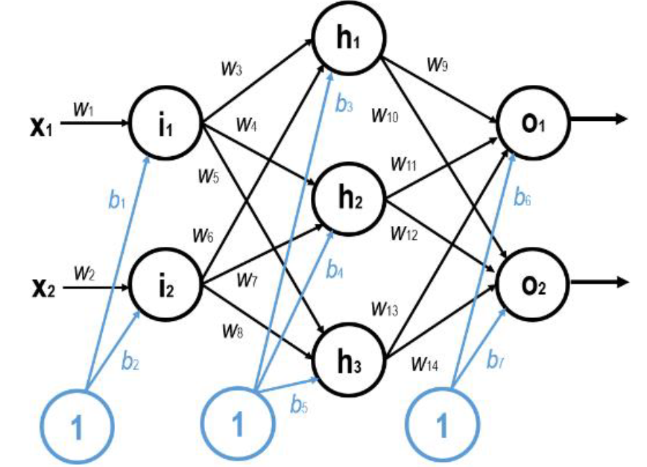
Toy Example 1
https://www.spiedigitallibrary.org/conference-proceedings-of-spie/11113/111131P/Training-artificial-neurons-an-introduction-to-machine-learning/10.1117/12.2530718.full

Slide 7
Poor Outputs
0.8645
0.6624

Slide 8
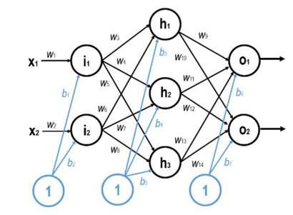
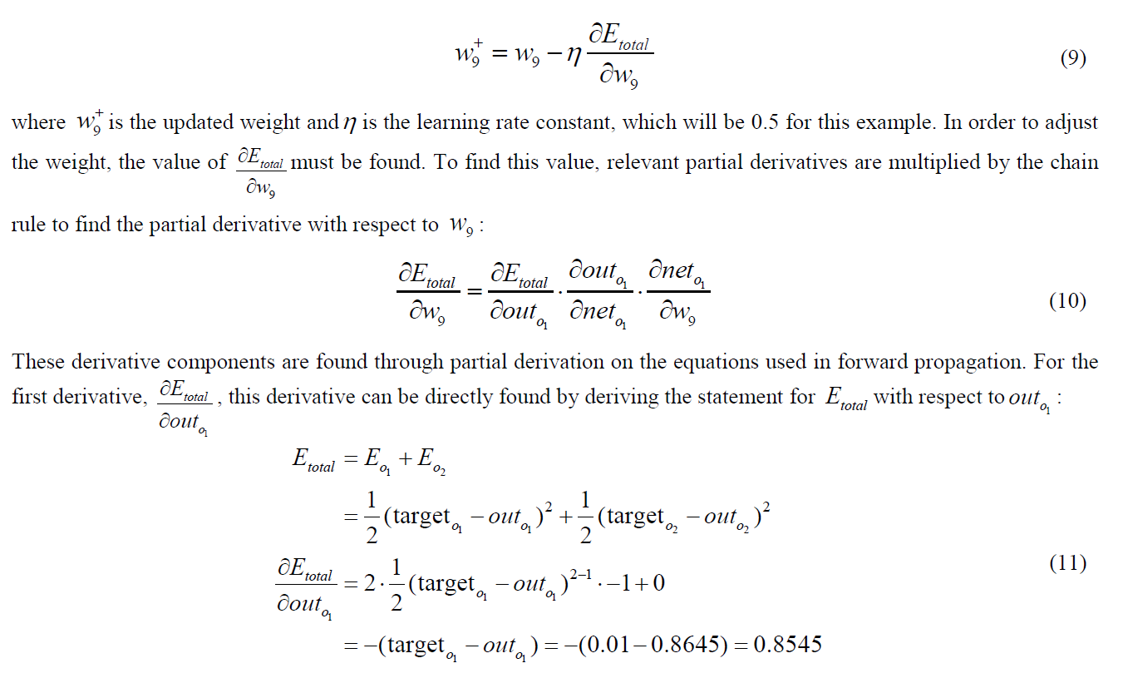
Refinement of w₉ (Similarly, Other Parameters)
Weight
net
out

Slide 10
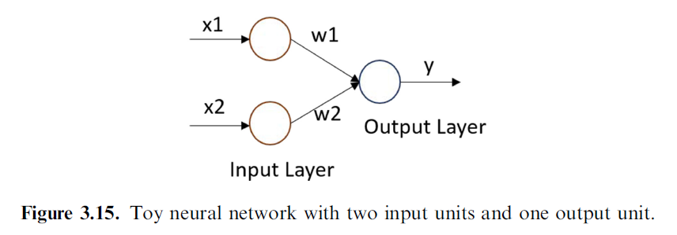
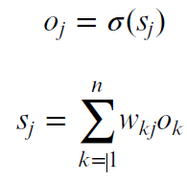
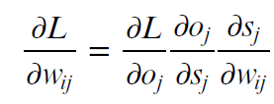
Key Points in BP Derivation
w: Weight
s: net
o: out

Slide 11
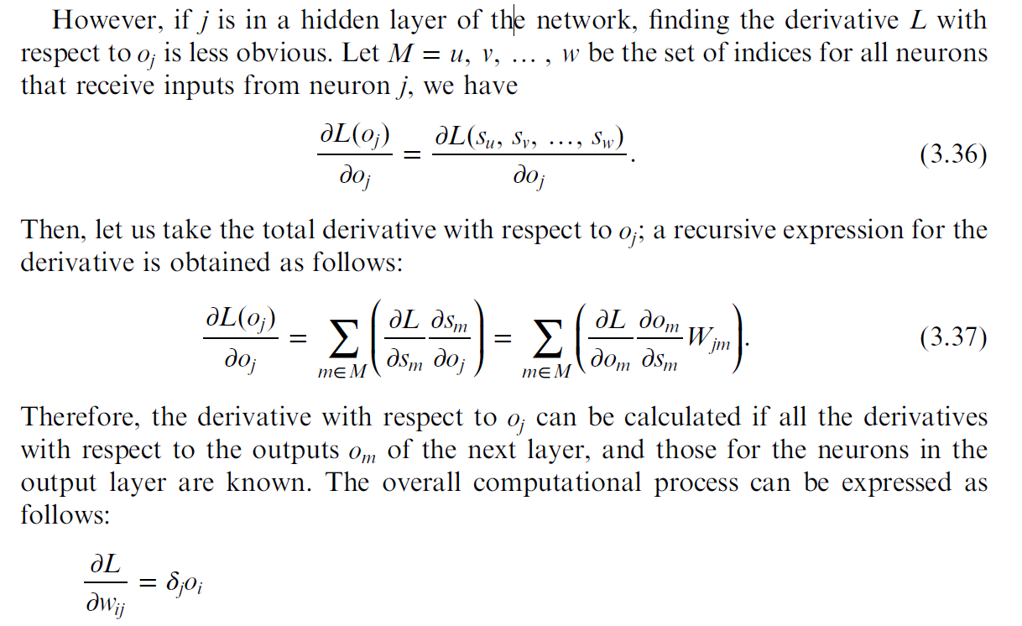

Slide 12
Python, Colab, TensorFlow, &
MNIST Example
Christopher Wiedeman, Huidong Xie, and Ge Wang
wiedec@rpi.edu, xieh2@rpi.edu, and wangg6@rpi.edu
Sept. 10, 2021
Notes:
Hello, since Professor Wang has a conference today out of town, I will give this hands-on introduction based on this PPT we prepared together. As he mentioned last time, we will have deep learning final projects by the end of the semester. Tentatively, we will have five lectures on deep learning hands-on, including this one.

Slide 13
Why Python?
High-level, Relatively Simple
Many Libraries/Frameworks
(NumPy, TensorFlow, etc.)
A most popular language
Notes:
Python is a high level, object-oriented and relatively simple programming language.

Slide 14
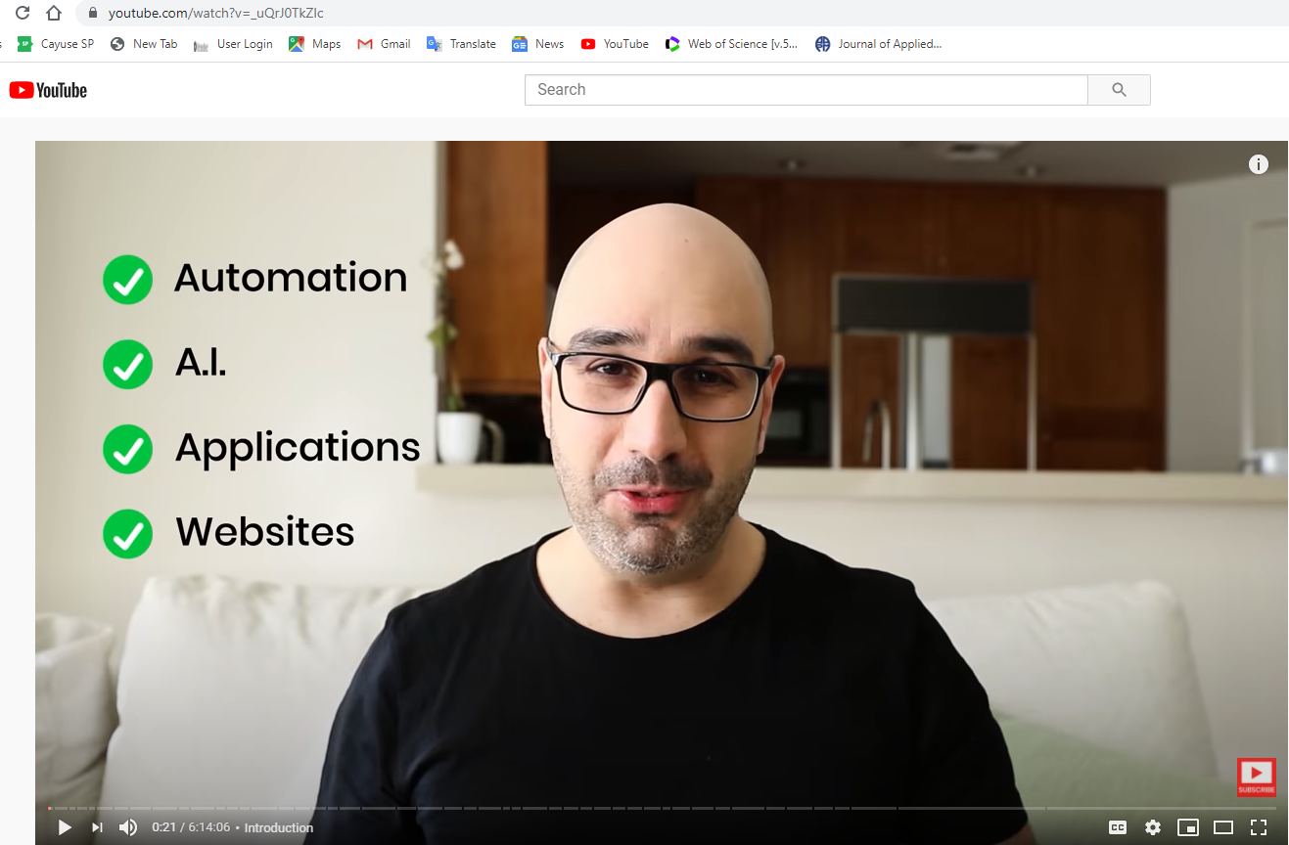
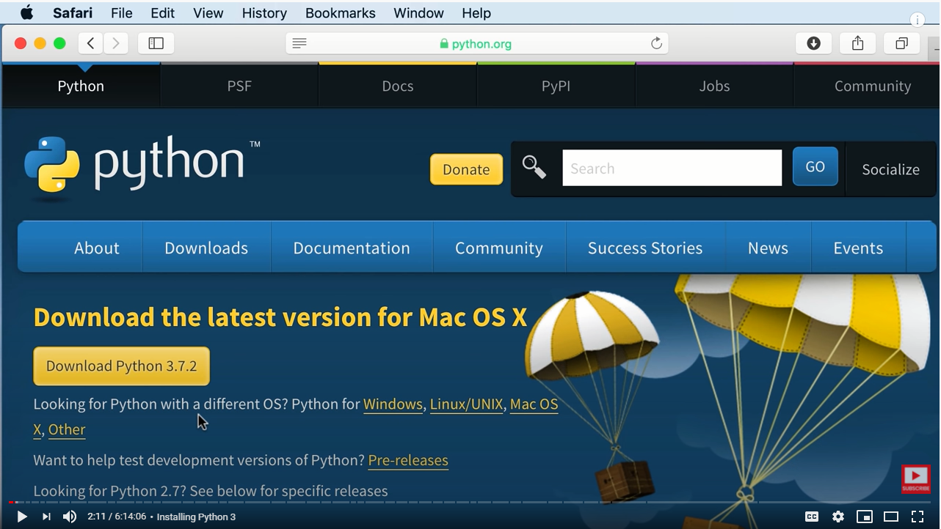
Python Tutorial (Optional)
https://www.youtube.com/watch?v=_uQrJ0TkZlc (6 hours, 12M views)

Slide 15
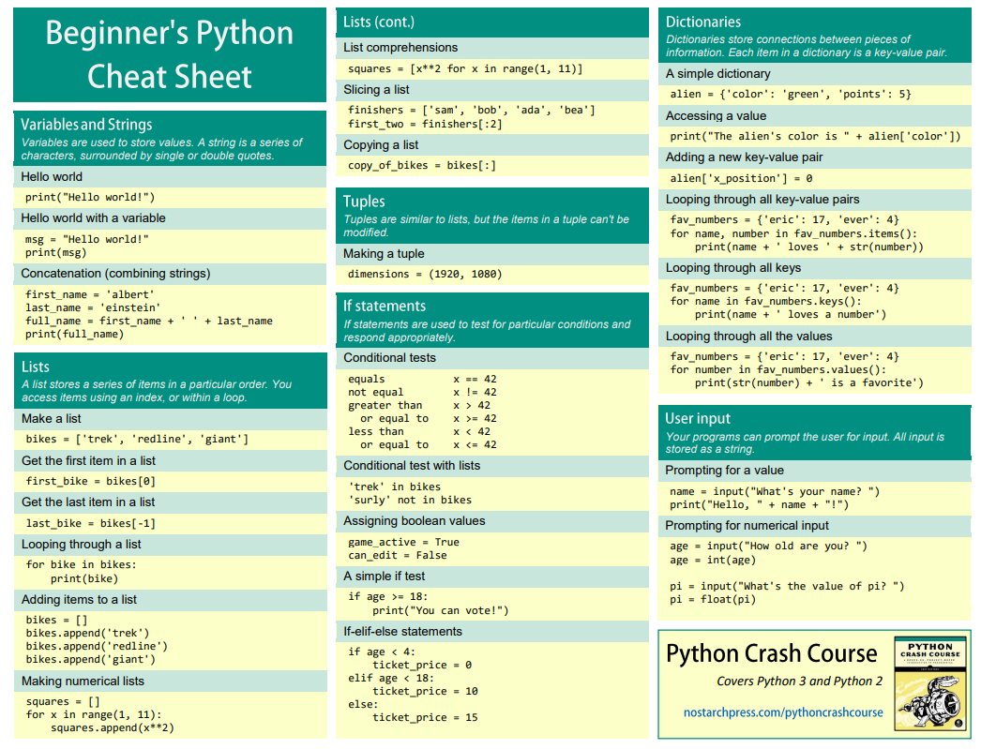
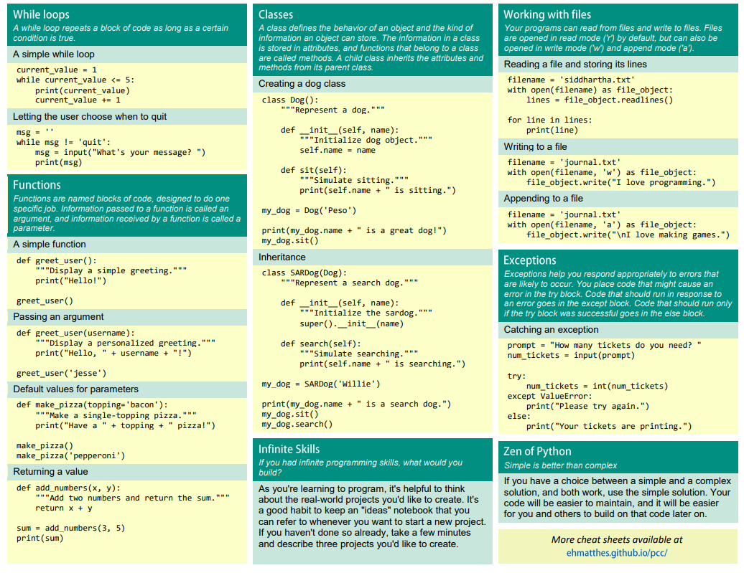
Cheat Sheet: https://ehmatthes.github.io/pcc/cheatsheets/README.html

Slide 16
Key Elements for Programming
Data I/O Processing

Slide 17
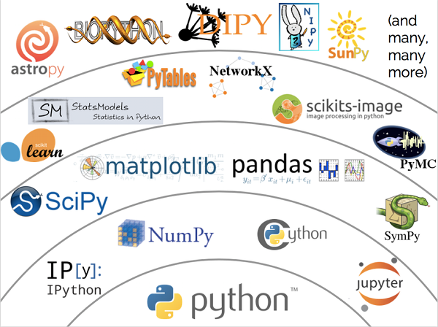
Python’s Ecosystem
https://medium.com/@Alibaba_Cloud/mars-matrix-based-universal-distributed-computing-framework-a88909afa4ac

Slide 18
Jupyter

Slide 19
Jupyter => Google Colab
Jupyter is a web-based integrative development environment for notebooks, codes, and data. Namely, a coding environment on the web.
Google Colab is a free Jupyter notebook environment that requires no setup and runs entirely on web. It provides free GPU, which is necessary for deep learning.

Slide 20
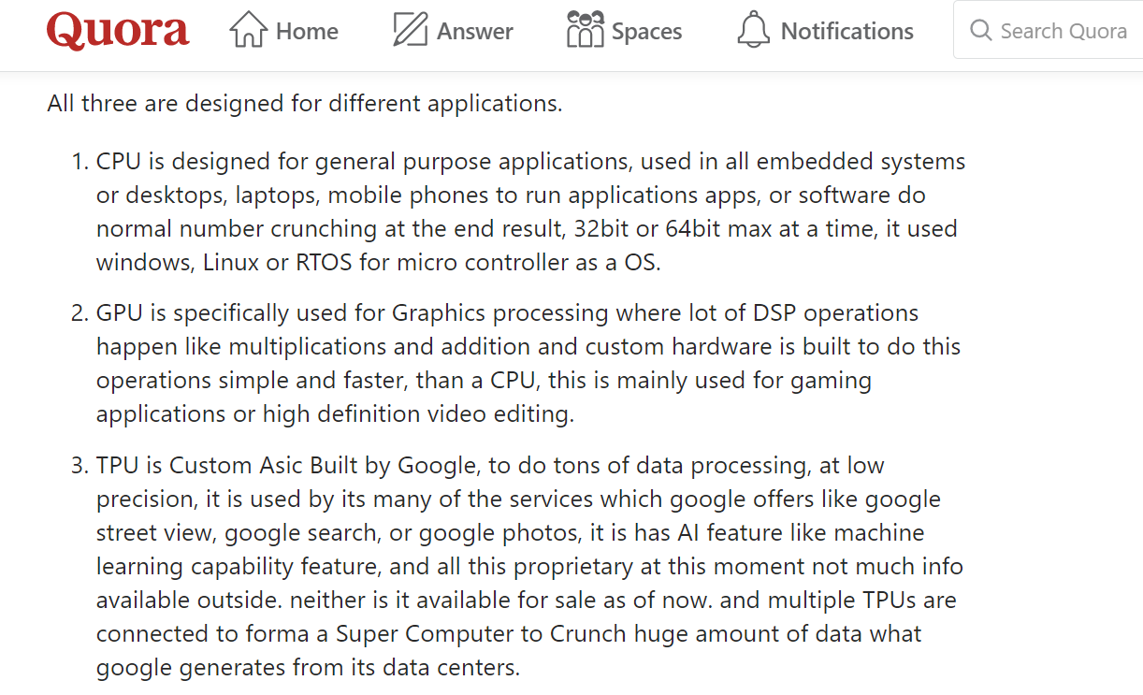
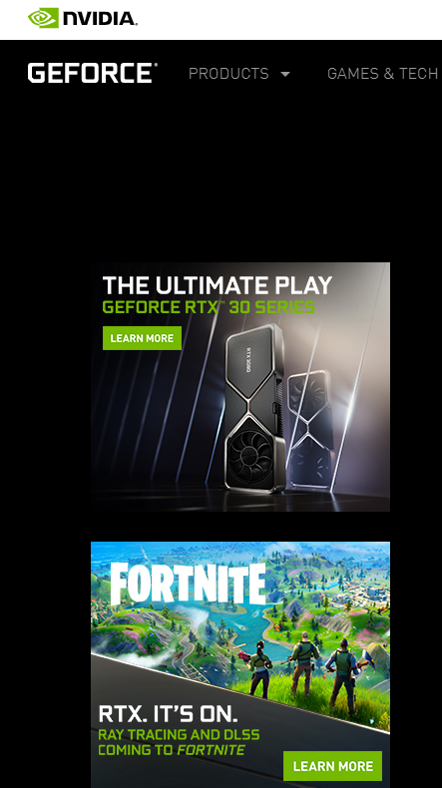
CPU, GPU & TPU

Slide 21
Getting Started
Open the Web Browser
Google “Google Colab”
Click the First Link “Getting Started”;
On the Upper Left Corner, Click “File->New Python3 Notebook” (Log into Your Google Account & Use Your Google Drive (More Later))
Ready to Code!

Slide 22
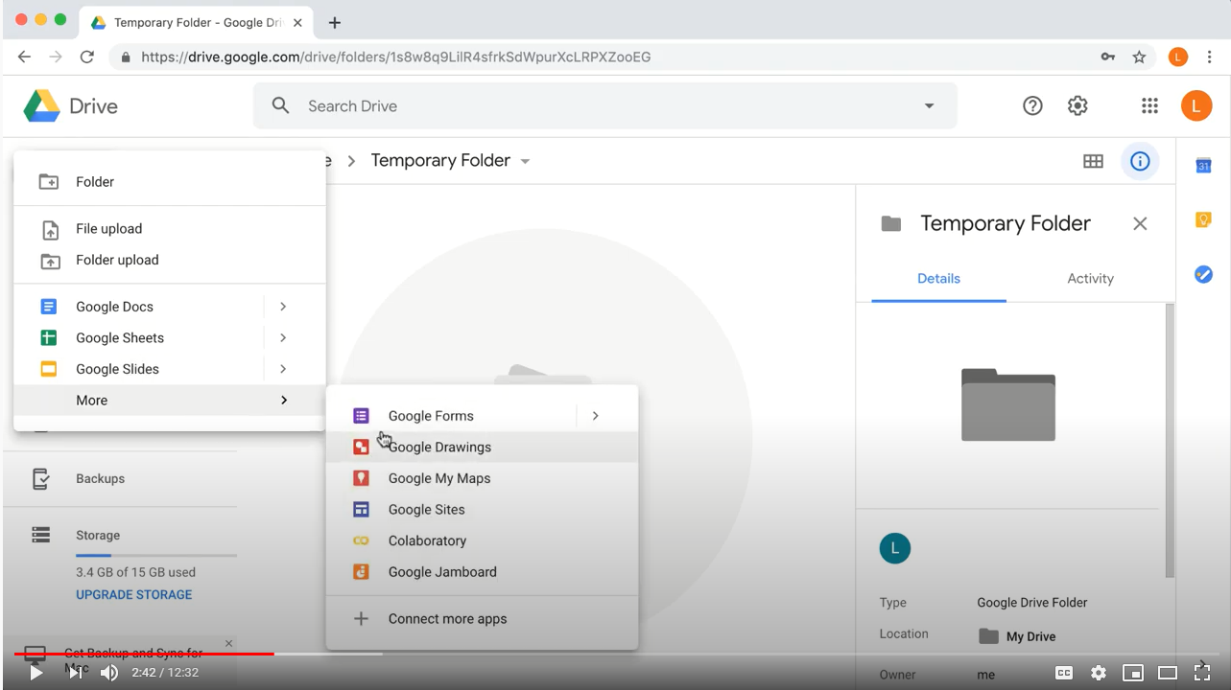
Google Colab
https://www.youtube.com/watch?v=vVe648dJOdI (12 Minutes)

Slide 23
Python Example
name = input("What is your name: ") # Wait for input
print(“Hello ” + name) # Print what you typed
What is your name: Ge # Enter my first name
Hello Ge # Print a phrase
print(“Bye Covid-19”) # Print a string “Bye Covid-19”
Bye Covid-19 # This color signifies Python input or output
print(‘*’ * 10) # Repeat * 10 times
**********

Slide 24
Python Example
a = 5 # Define variable a
b = 4.0 # Define variable b
c = a * b**2 # Compute a * b^2, assign the result to c
print(c) # Print c
80.0 # Data type is float

Slide 25
Python Example
name = ‘abcdefg'
print(name[0], name[1], name[-1]) # Print selected elements
a b g
print(name[0:6]) # Print the 1st to the 6th elements
abcdef
digits = [0,1,2,3,4,5,6,7,8,9,10]
print(digits[0::2]) # Print from 0 to the end with step 2
[0, 2, 4, 6, 8, 10]
digits = list(range(11)) # Generate the same list

Slide 26
Python Example
birth_year = input("Birth year: ") # Your input is a string
print(type(birth_year)) # Print the type of your input
birth_year = int(birth_year) # Convert the string to an integer
print(type(birth_year)) # Print the type of the result
age = 2019 - birth_year # Compute the age
print(age) # Print age
Birth year: 1999
<class 'str’>
<class 'int’>
20

Slide 27
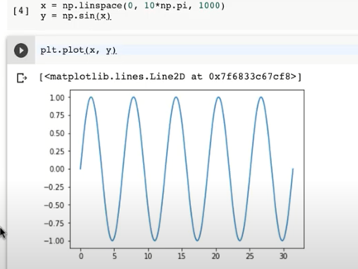
NumPy Import
import numpy as np # Import the package first before it can be used

Slide 28
NumPy Example
a = np.linspace(0, 360, 300, endpoint=False)
# Generate an np.array of 300 elements
# when endpoint=False, the elements distributed in [0, 360)
# when endpoint=True, the elements distributed in [0, 360]

Slide 29
NumPy Example
a = np.array([1,2,3])
b = a
b[0] = 500
print(b)
print(a)
[500 2 3]
[500 2 3]
# Use b = a.copy() to solve the problem
# This is because both b and a point to the same address

Slide 30
NumPy Example
print(a.dtype) # Print the type of the np array
int64 # By default, all numerical elements are int 64
a = np.array([1,2,3], dtype=np.int16)
# Specify the type to save memory
print(a.dtype)
int16

Slide 31
NumPy Example
a = np.array([1,2,3])
b = np.array([1,5,3])
c=a+b
print(c)
[2 7 6] # Output the matrix c
a + b
a * 2
a * b
np.sin(a) # Element-wise operations

Slide 32
NumPy Example
a = np.array([[1,2,3,4,5,6,7],[8,9,10,11,12,13,14]])
print(a)
[[ 1 2 3 4 5 6 7] [ 8 9 10 11 12 13 14]]
print(a[0,:]) # Print the first row, ‘:’ means all the elements [ 1 2 3 4 5 6 7]
print(a[0,2]) # Print the 3rd element in the 1st row 3

Slide 33
NumPy Example
import numpy as np # Import the package first before it can be used
a = np.array([1,2,3]) # Define an array with element [1,2,3]
print(a)
[1 2 3]
b = np.array([[1,2,3],[4,5,6]]) # Define a 2D array
print(b)
[[1 2 3] [4 5 6]]
print(a.ndim) # Print the dimension of the array a
1
print(b.ndim) # Print the dimension of the array b
2
print(a.shape) # Print the shape of a
(3,)
print(b.shape) # Print the shape of b
(2,3)

Slide 34
NumPy Example
a = np.ones((2,3))
b = np.full((3,2), 2)
# Generate a matrix with all elemental values equal to 2
print(np.matmul(a,b))
[[6. 6.]
[6. 6.]]
# a*b does not work since they have different dimensions
Use the matmul function to perform the matrix multiplication

Slide 35
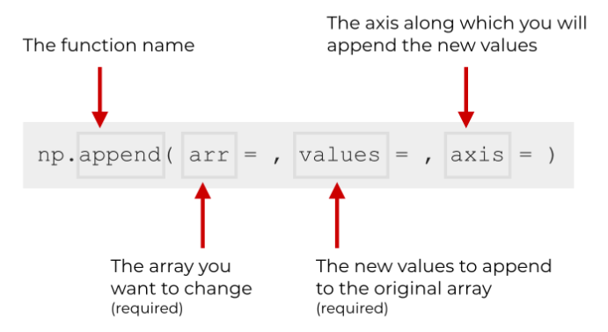
NumPy Example
a = np.random.randint(1, 100, (3,3), dtype=np.int32)
# Generate random integers within [1, 100) of int32 type
b = np.random.randint(1, 100, (3,3), dtype=np.int32)
c = np.append(a,b,axis=0)
print(c.shape)
print(c)
(6, 3)
[[22 9 57]
[ 4 76 87]
[42 56 99]
[49 35 27]
[20 58 21]
[41 61 38]]
https://www.sharpsightlabs.com/blog/numpy-append/

Slide 36
Turing’s Halting Problem
In computability theory, the halting problem is the problem of determining, from a description of an arbitrary computer program and an input, whether the program will finish running, or continue to run forever. Alan Turing proved in 1936 that a general algorithm to solve the halting problem for all possible program-input pairs cannot exist.
https://en.wikipedia.org/wiki/Halting_problem#Sketch_of_proof

Slide 37
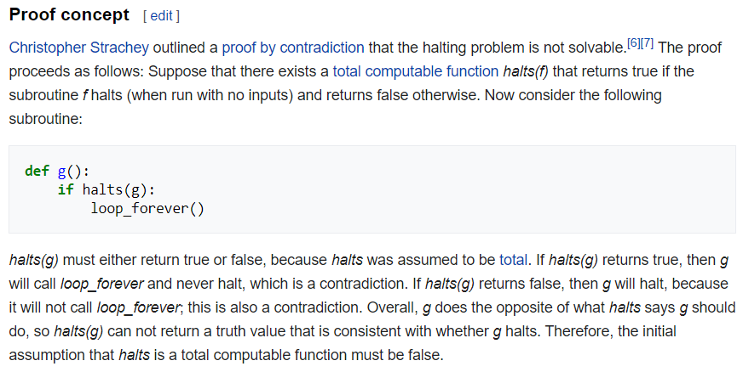

Slide 38
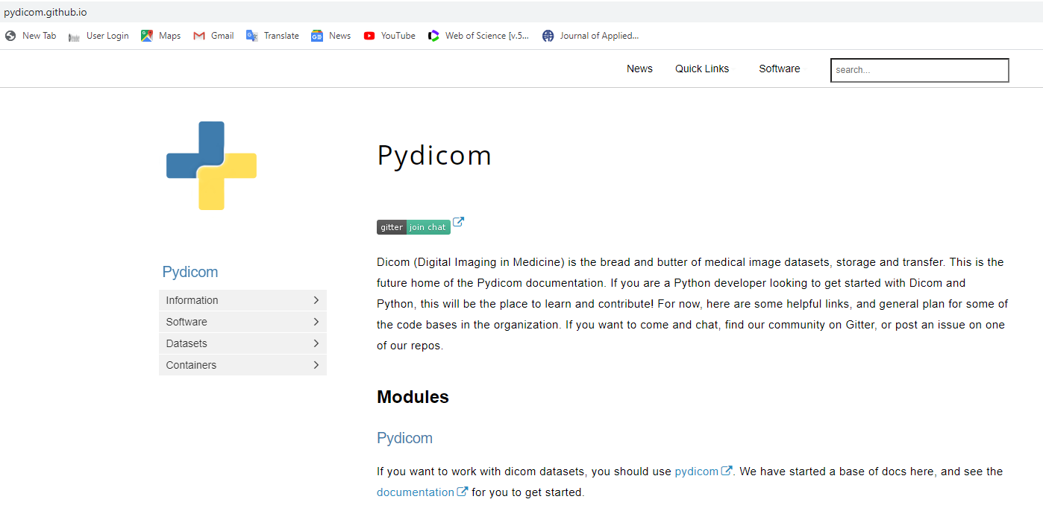
Pydicom Website

Slide 39
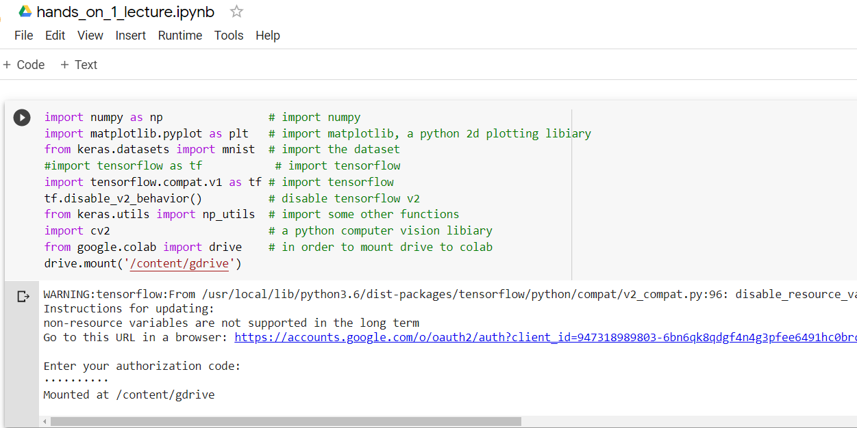
Linking Colab & Google Drive
You must upload data to your google drive so that you can read in the Jupyter notebook. Please mount your gdrive to Colab!

Slide 40
Mounting Google Drive as Needed
Question: I mounted gdrive already. When I log into my Colab in the future, should I mount again every time?
Answer: Yes. Whenever Google Colab 'ends the session' (which can happen if it's idle for long enough), it clears its memory, including all variables and any mounts to the drive. If the drive is already mounted, then there's no harm in running the code again (it will simply say that's it's already mounted).

Slide 41
Basic Linux Commands
ls: Show all content in the current directory
cd: Go to any directory. Ex: cd gdrive.
pwd: Return the current directory
cd.. : Return to the previous directory
cd/: Return to the root directory
mkdir : Create a directory

Slide 42
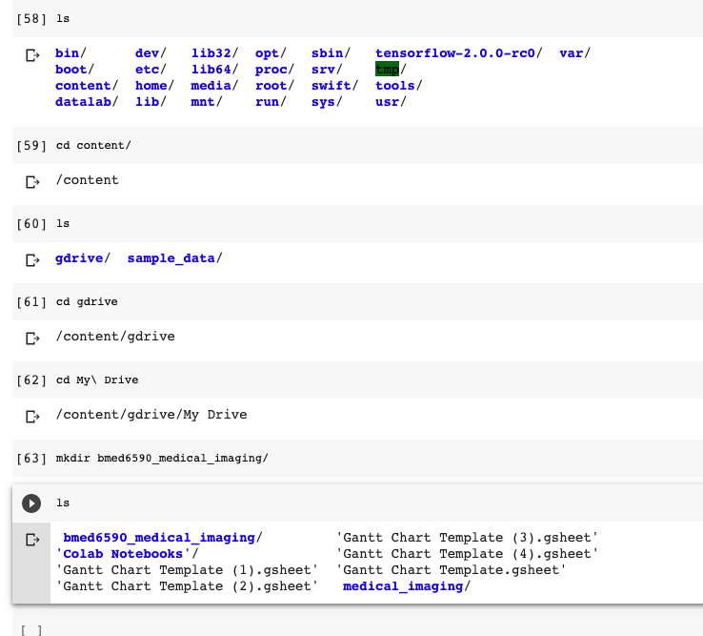
Directory Creation
Use the commands described previously, go to the ‘My Drive’ and create a new directory ‘F21-MI2-Data’
Mkdir F21-MI2-Data
Notes:
**NOTE: Code shows bmed6590_medical_imaging as directory name, but instructions list bmed6590medical_imaging (missing underscore) as name. Just ensure consistency

Slide 43
Pydicom
We can read a medical image using python
Medical images have a DICOM format called .dcm or .IMA
Pydicom is a python package to work with DICOM files. The pydicom package is not natively installed in Colab. Please do the following to install this package:
pip install pydicom

Slide 44
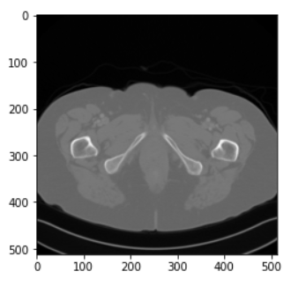
Image Input
Drag the medical image on LMS to the folder you just created in your google drive. If you did everything correctly, you should be able to see the folder.
import pydicom # import package first
img = pydicom.read_file(‘/content/gdrive/My Drive/F20-MI2-Data/Mayo_medical_img.IMA’)
print(img) # Print the header info
img = img.pixel_array # Obtain the image
from matplotlib import pyplot as plt
plt.imshow(img, cmap='gray’)
plt.show()
https://www.aapm.org/GrandChallenge/LowDoseCT/

Slide 45
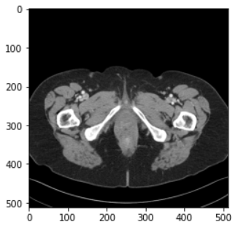
Image Normalization
def normalize(img, lower=-160, upper=240): # Normalization
img = (img-1024.0 - lower) / (upper-lower)
# Adjust contrast and brightness (“img-1024” is to get correct CT numbers)
img[img>1.0] = 1.0 # Set pixels above upper limit to 1
img[img<0.0] = 0.0 # Set pixels below lower limit to 0
return img
plt.imshow(normalize(img), cmap='gray')
plt.show()
plt.imshow(img, cmap='gray’)
plt.show() # After normalization
Notes:
*Note: Normalize function is defined, but never run on img. Shouldn’t code include:
img = normalize(img)

Slide 46
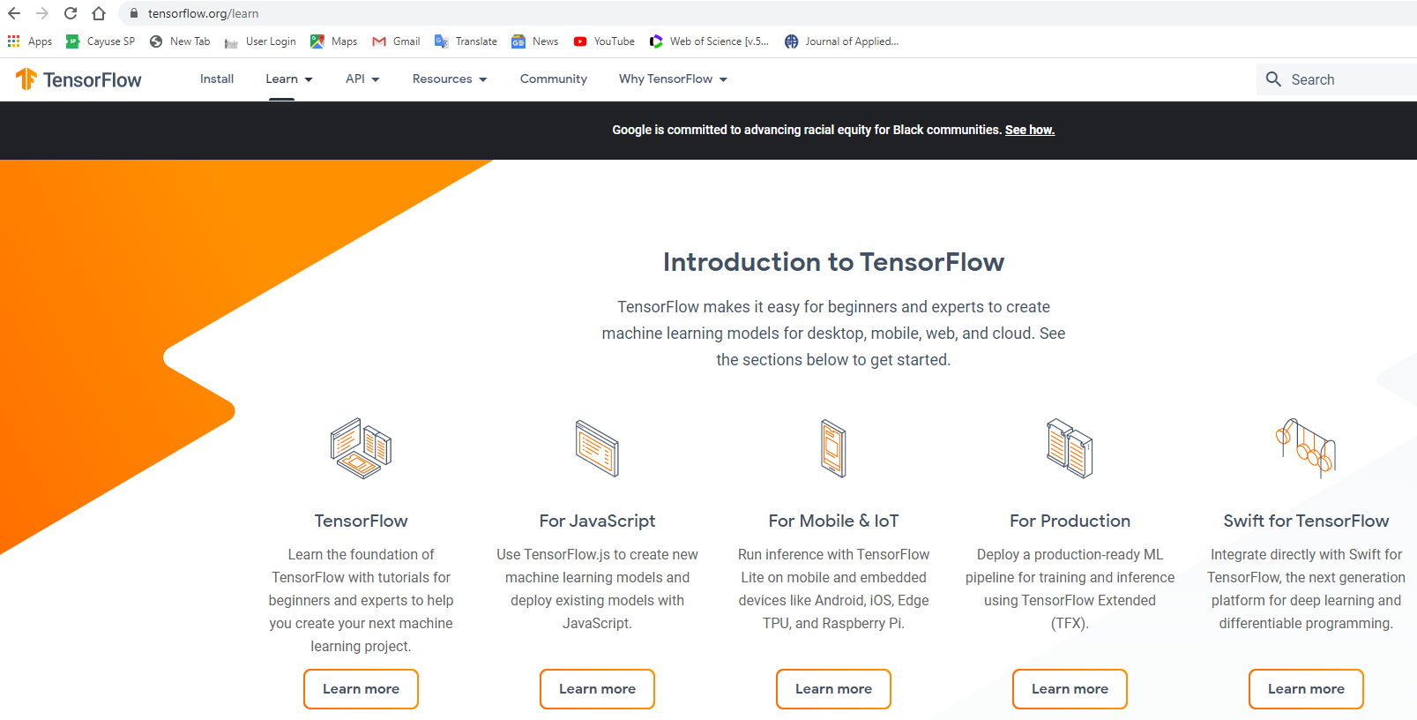
TensorFlow

Slide 47
Homework: Going through PreLab
Preview: Hands-on #1 in my dropbox https://www.dropbox.com/home/MIMI-F21
If you cannot access the dropbox, please email me.
Open Google Colab in a web browser:
https://colab.research.google.com/notebooks/basic_features_overview.ipynb
Go to ‘File-->Upload Notebook‘;
Select 'Hands_On_1_PreLab.ipynb' in the dialogue box;
Please put a white square in the CT image, and write a complete report showing your work step by step.
Homework Rule: Name your homework report in the format MI_Date_Name, where “Date” specifies when the lecture was delivered, and “Name” is your initials+last name. Please convert your homework report into PDF, update to LMS regularly (5 working days after assignment), and submit an integrated single PDF before the final exam.

