Slide 1
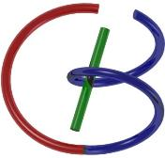
38655 BMED-2300-02
Lecture 20: MRI Pulse Sequences
Ge Wang, PhD
Biomedical Imaging Center
CBIS/BME, RPI
wangg6@rpi.edu
April 10, 2018

Slide 2
BB Schedule for S18
Tue | Topic | Fri | Topic
1/16 | Introduction | 1/19 | MatLab I (Basics)
1/23 | System | 1/26 | Convolution
1/30 | Fourier Series | 2/02 | Fourier Transform
2/06 | Signal Processing | 2/09 | Discrete FT & FFT
2/13 | MatLab II (Homework) | 2/16 | Network
2/20 | No Class | 2/23 | Exam I
2/27 | Quality & Performance | 3/02 | X-ray & Radiography
3/06 | CT Reconstruction | 3/09 | CT Scanner
3/20 | MatLab III (CT) | 3/23 | Nuclear Physics
3/27 | PET & SPECT | 3/30 | MRI I
4/03 | Exam II | 4/06 | MRI II
4/10 | MRI III | 4/13 | Ultrasound I
4/17 | Ultrasound II | 4/20 | Optical Imaging
4/24 | Machine Learning | 4/27 | Exam III
Office Hour: Ge Tue & Fri 3-4 @ CBIS 3209 | wangg6@rpi.edu
Kathleen Mon 4-5 & Thurs 4-5 @ JEC 7045 | chens18@rpi.edu

Slide 3
MRI Pulse Sequences
MRI Scanners
Magnet for B0
Gradient Coils for Gx, Gy & Gz
RF Coil for B1
Pulse Sequences
More on Spin Echo & Gradient Echo
MR Angiography
DWI & Spectroscopy
MRI Agents & Safety
Brain Initiatives
Novel Ideas

Slide 4
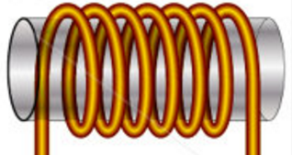
Signal Model for a 90˚ Pulse
Rotating Transverse Component of M Induces a Current in Quadrature Coils
In the Rotating Frame:
Repeated after TR:
Total Signal:
z
s_{y}(t)
M
y’
x’
s_{x}(t)
Determined by
Proton Density ρ, T₁, & T₂ (Biological)
B₀, TR, TE, & t (Technical)

Slide 5
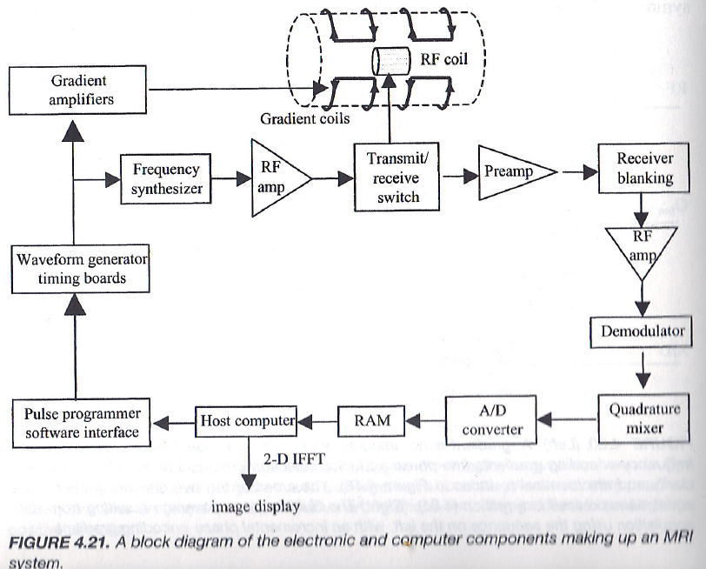
MRI System Diagram

Slide 6
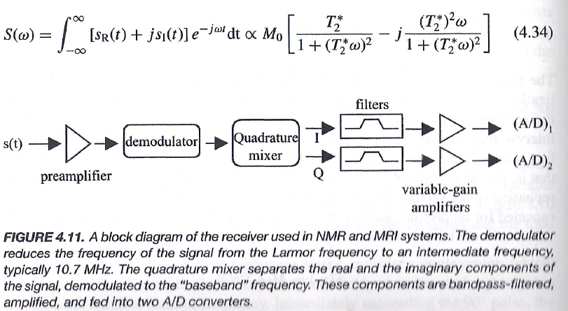
Signal Detection

Slide 7
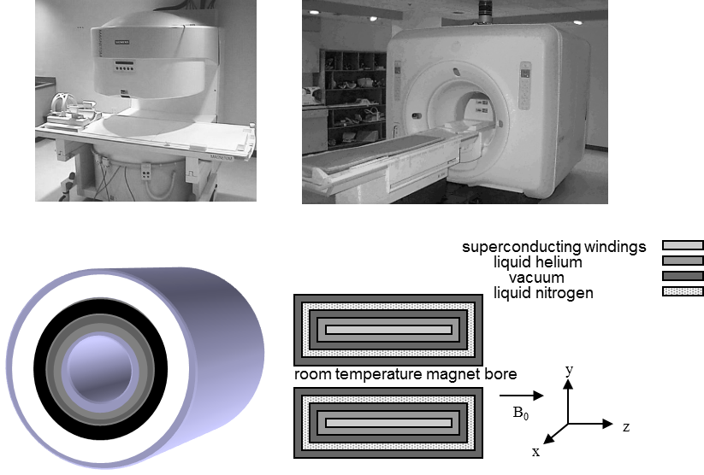
Superconducting Magnet

Slide 8
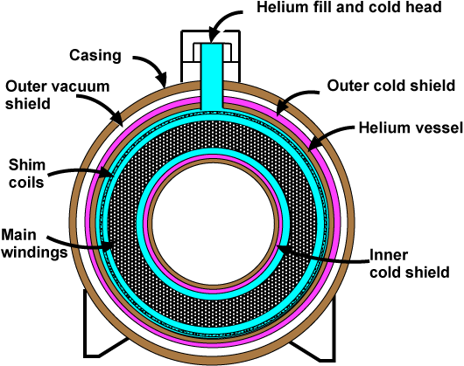
Superconducting Magnet
http://www.mriquestions.com/superconductive-design.html
http://blog.sciencenet.cn/blog-3004473-954898.html (Teleportation 8-)

Slide 9
Gradient Coils
y
z
x
B_{z}
B_{y}
B_{x}
z
y
x

Slide 10
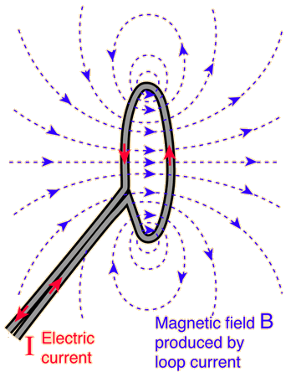
Simple Idea Behind Gradient Coils

Slide 11
Gradient Coils
Sounds Are Generated during Imaging due to Mechanical Stress within Gradient Coils

Slide 12
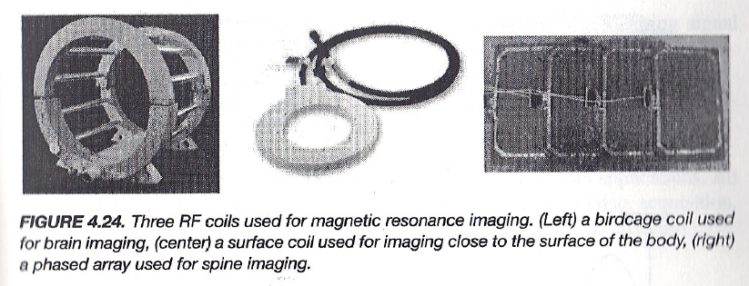
RF Coils

Slide 13
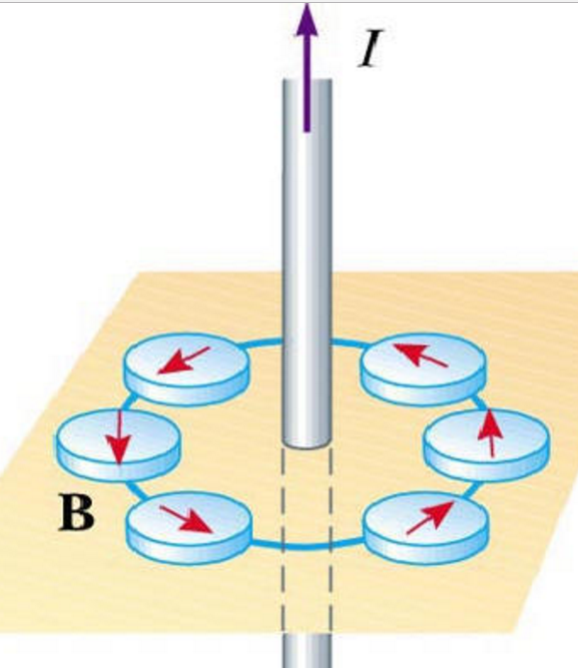
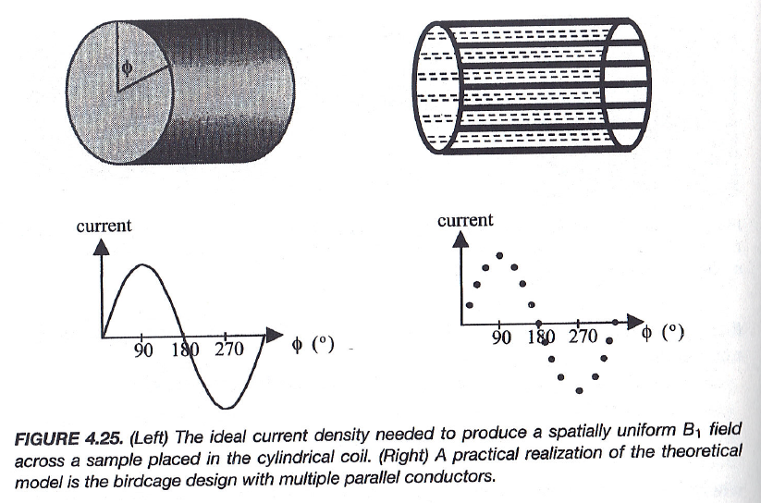
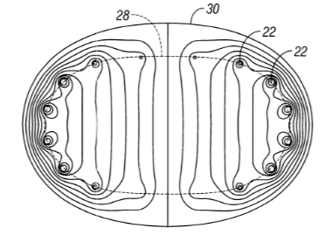
Uniform B1 with Bird Cage

Slide 14
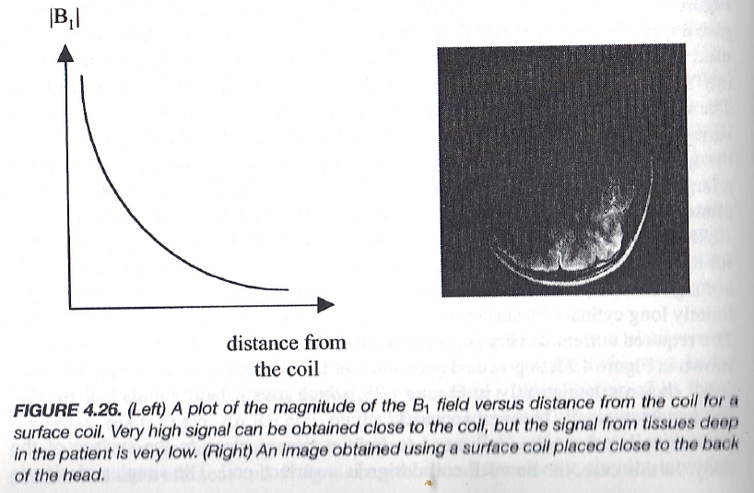
Non-uniform B1 with Surface Coils

Slide 15
MRI Pulse Sequences
MRI Scanners
Magnet for B0
Gradient Coils for Gx, Gy & Gz
RF Coil for B1
Pulse Sequences
More on Spin Echo & Gradient Echo
MR Angiography
DWI & Spectroscopy
MRI Agents & Safety
Brain Initiatives
Novel Ideas

Slide 16
Phase & Frequency Encoding (τ->t)
γG_{x} t/2π, γ G_{y} τ_{pe}/2π
γG_{x} t/2π, γ G_{y} t/2π
γG_{x} τ_{pe_x}/2π, γ G_{y} τ_{pe_y}/2π
γG_{x} τ_{pe_x}/2π, γ G_{y} t/2π

Slide 17
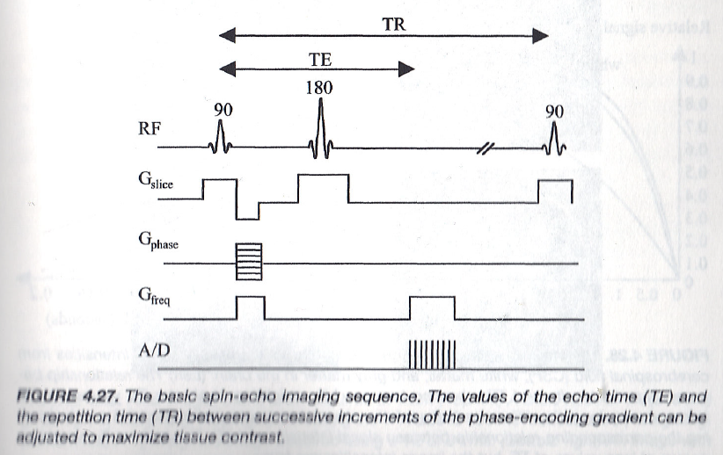
Spin-Echo Imaging Sequence
Re-phasing for
Gradient Echoes

Slide 18
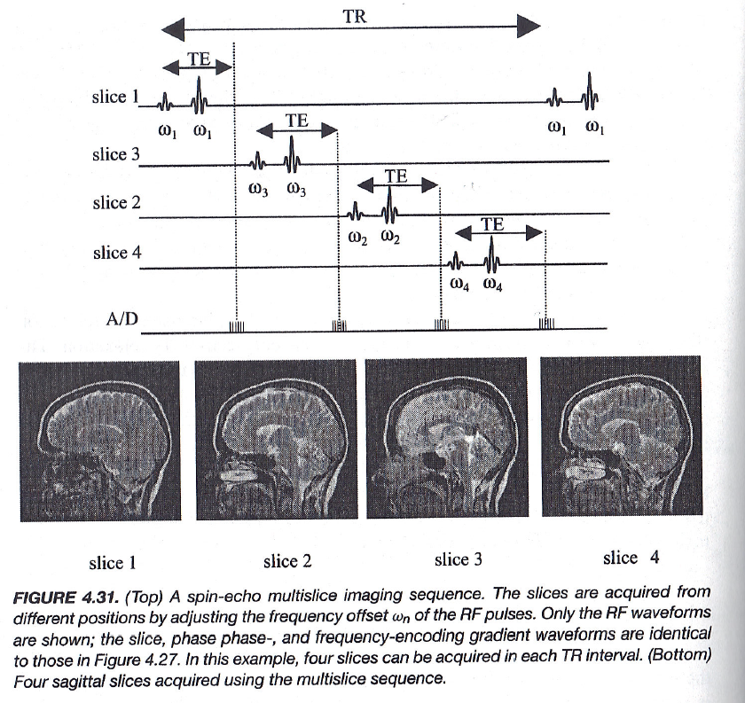
Multi-slice Imaging

Slide 19
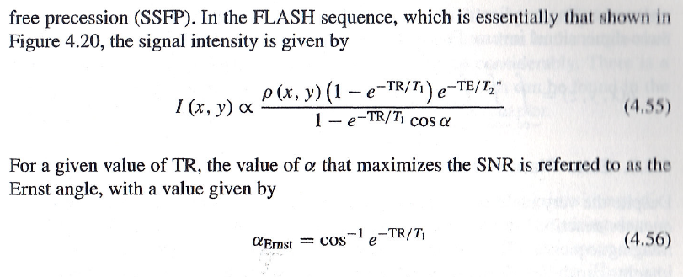
Gradient Echo Imaging

Slide 20
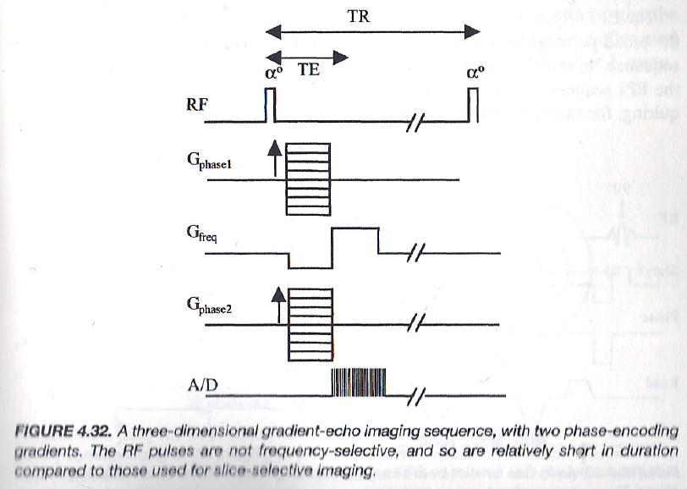
3D Gradient Echo Imaging

Slide 21
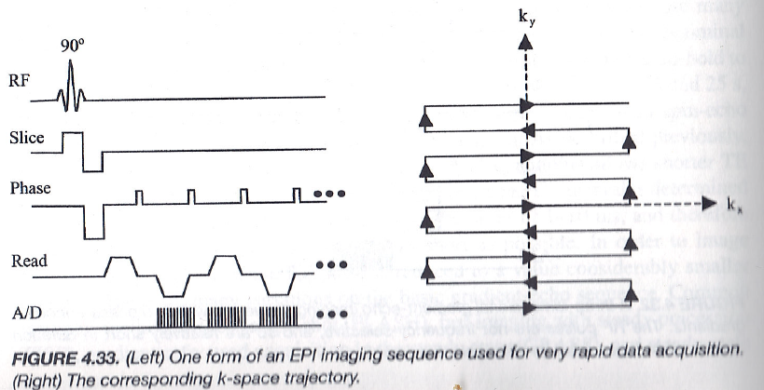
Echo-Planar Imaging

Slide 22
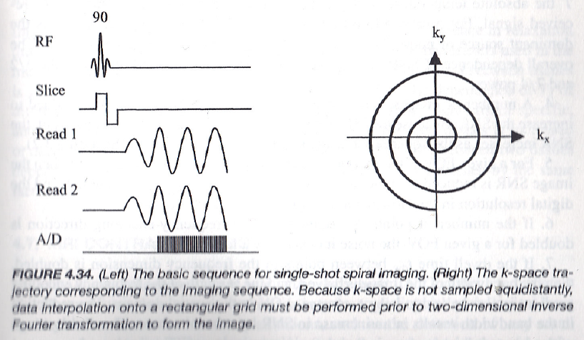
Spiral Imaging

Slide 23
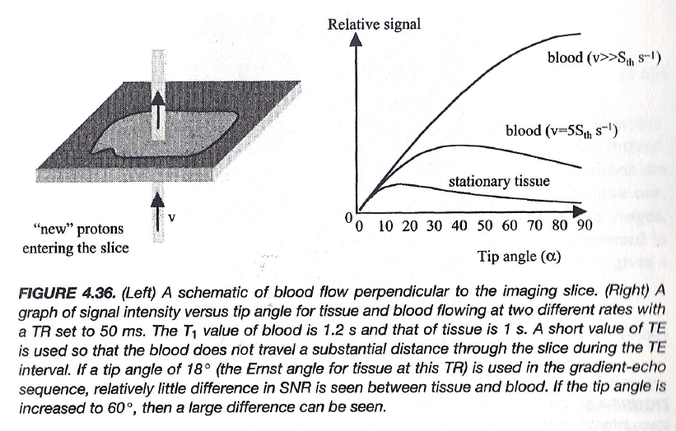
Time-of-Flight Imaging
Through-plane Mechanism

Slide 24
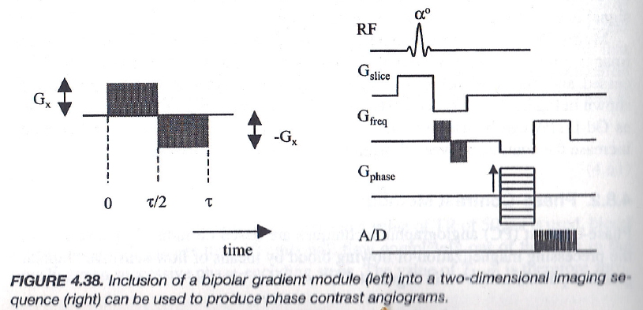
Phase-Contrast Imaging
In-plane/Any Direction Mechanism

Slide 25
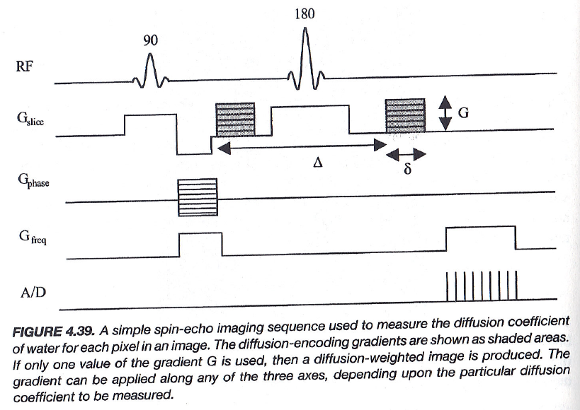
Diffusion Weighted Imaging

Slide 26
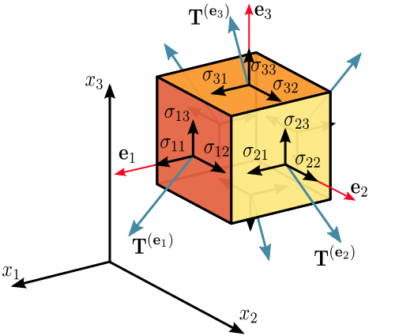
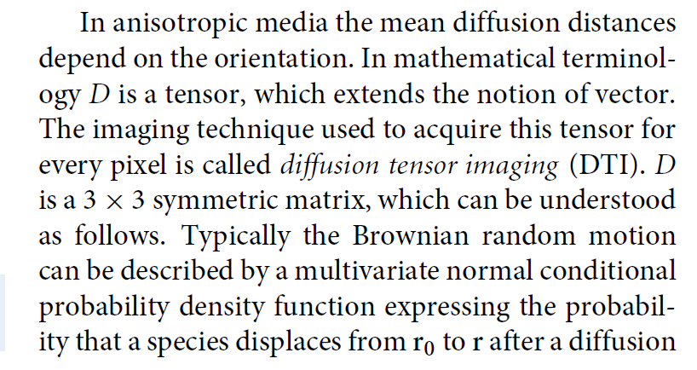

Slide 27
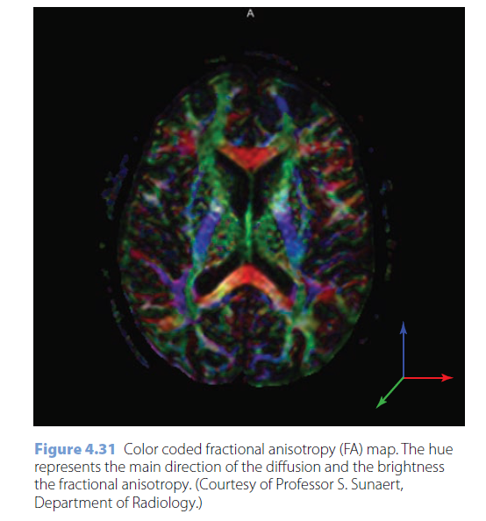

Slide 28
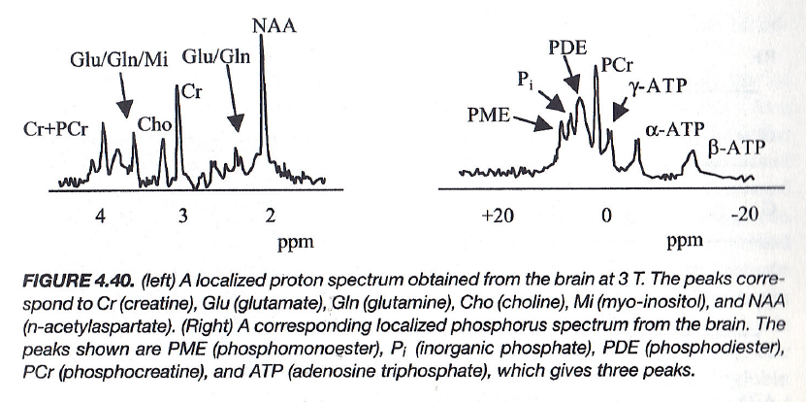
Spectral Imaging
Each voxel Emits Signals at Multiple Frequencies, Instead of
a Signal of a Single Frequency

Slide 29
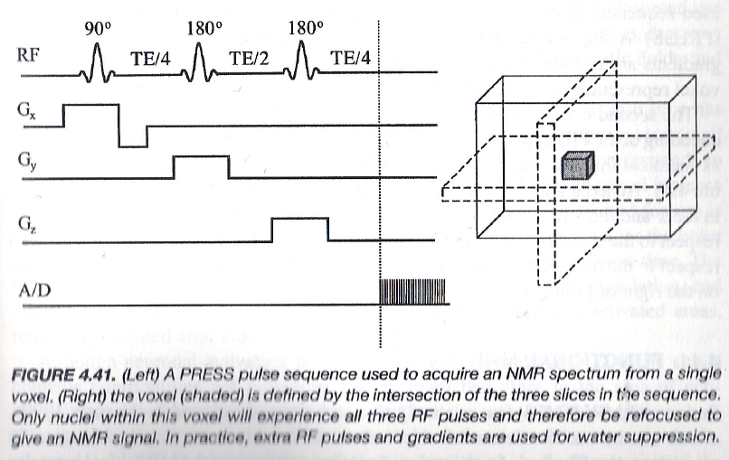
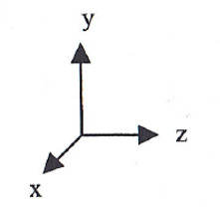
Spectroscopy Method 1: PRESS

Slide 30
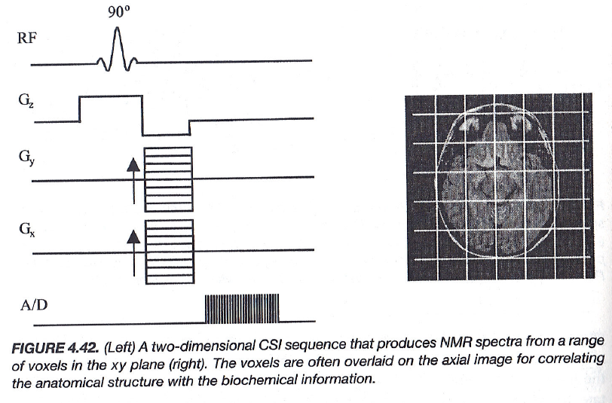
Spectroscopy Method 2: CSI

Slide 31
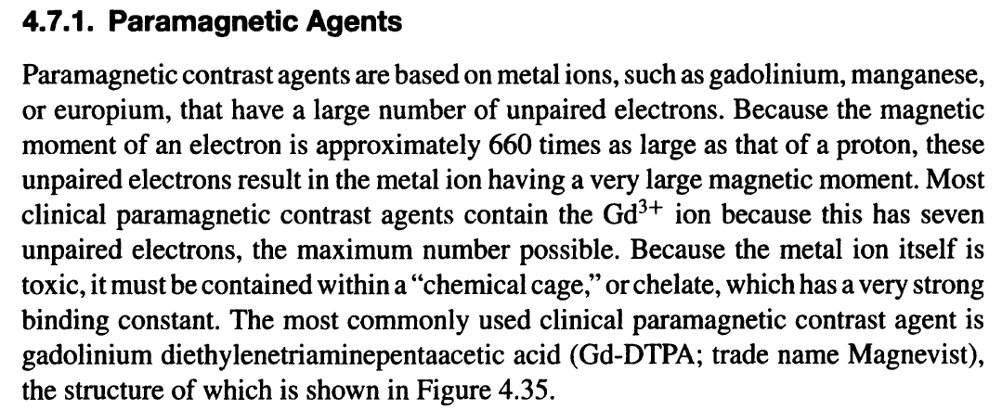
Example Agent: Magnevist

Slide 32
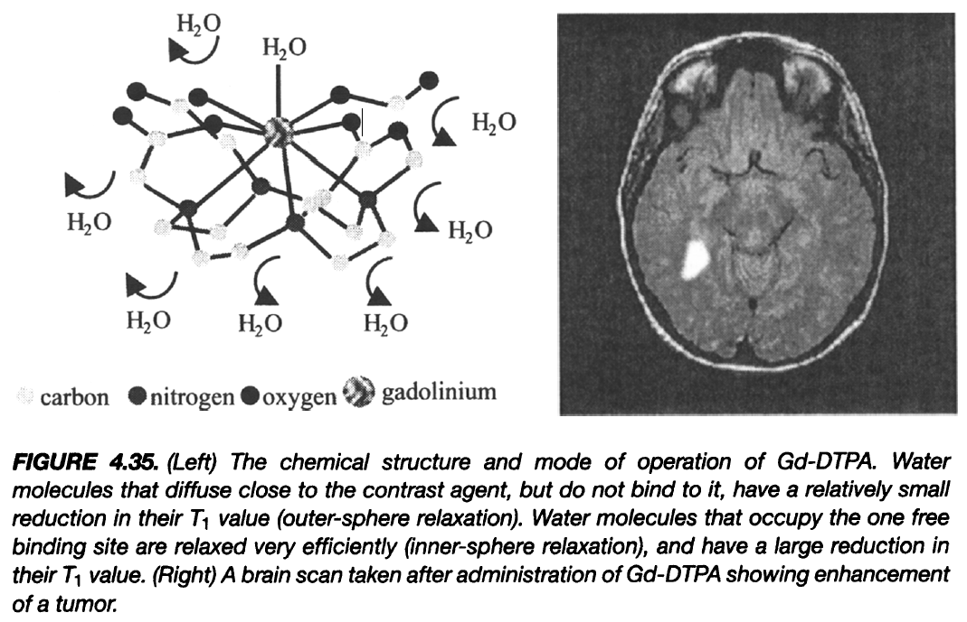
Example Imaging: Brain Tumor

Slide 33
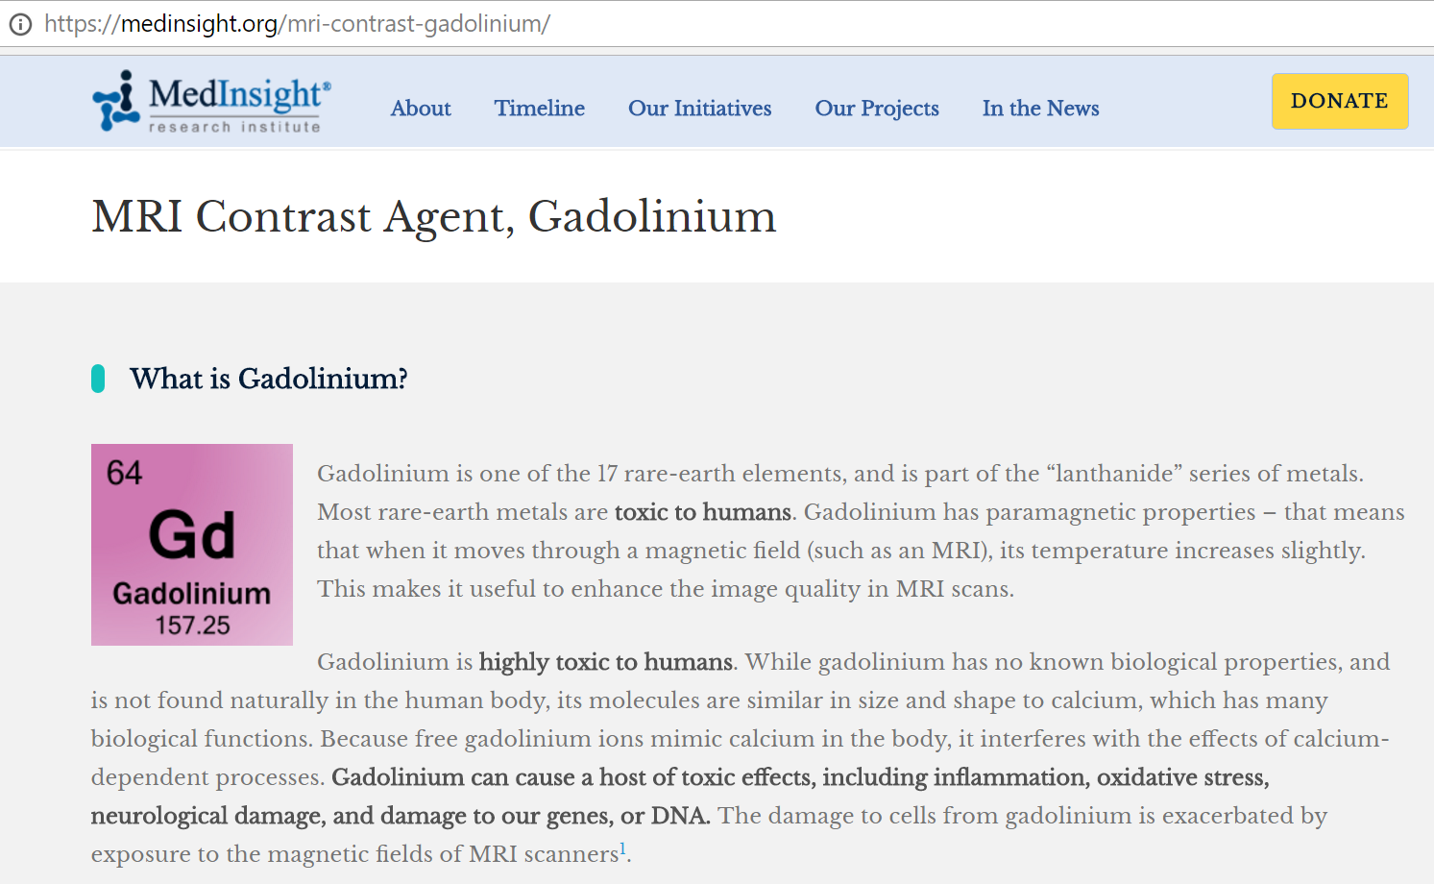
MRI Safety

Slide 34
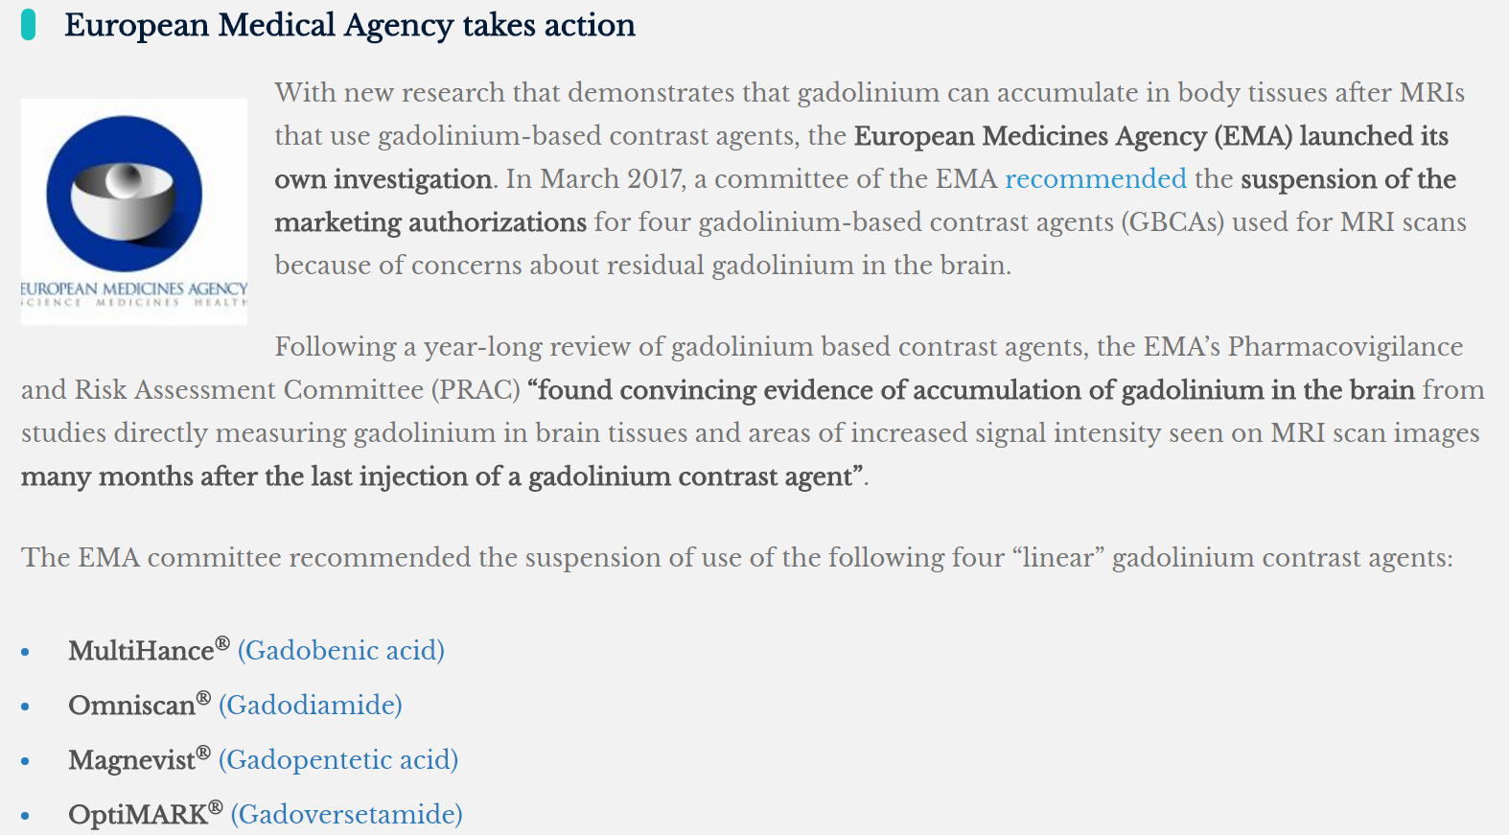
European Action

Slide 35
MRI Pulse Sequences
MRI Scanners
Magnet for B0
Gradient Coils for Gx, Gy & Gz
RF Coil for B1
Pulse Sequences
More on Spin Echo & Gradient Echo
MR Angiography
DWI & Spectroscopy
MRI Agents & Safety
Brain Initiatives
Novel Ideas

Slide 37
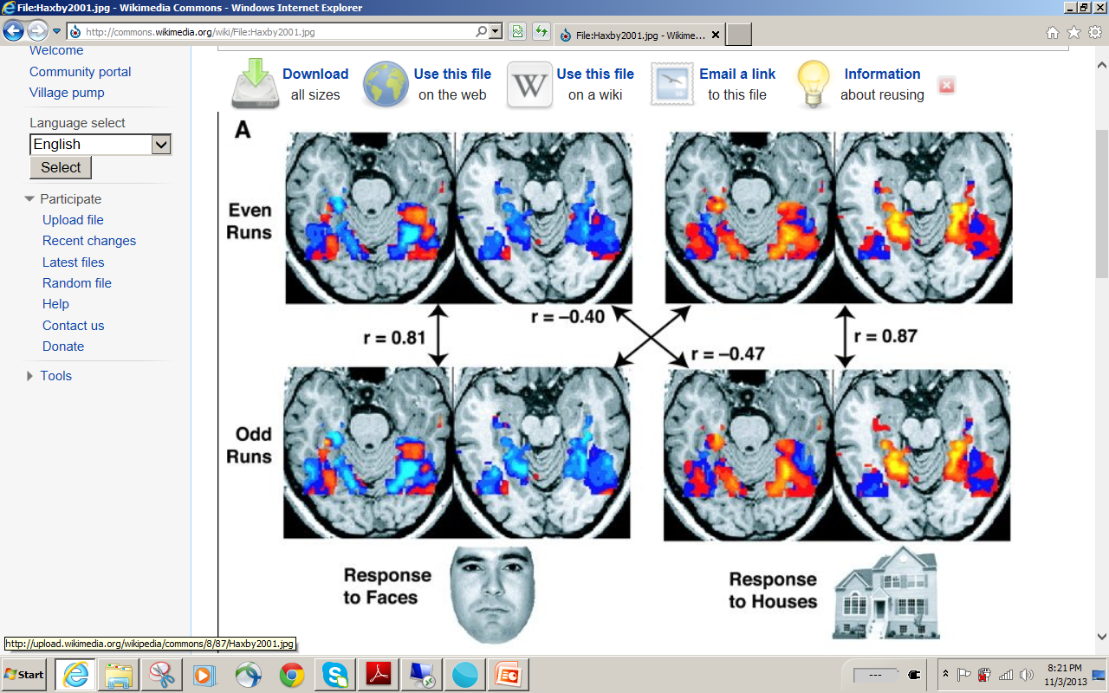

Slide 38
http://www.youtube.com/watch?v=8jc8URRxPIg

Slide 39
MRI Pulse Sequences
MRI Scanners
Magnet for B0
Gradient Coils for Gx, Gy & Gz
RF Coil for B1
Pulse Sequences
More on Spin Echo & Gradient Echo
MR Angiography
DWI & Spectroscopy
MRI Agents & Safety
Brain Initiatives
Novel Ideas

Slide 40
CT
PET/SPECT-CT
CT-MRI
CT-
MRI-
PET/SPECT
PET/SPECT
MRI
PET/SPECT-MRI

Slide 41
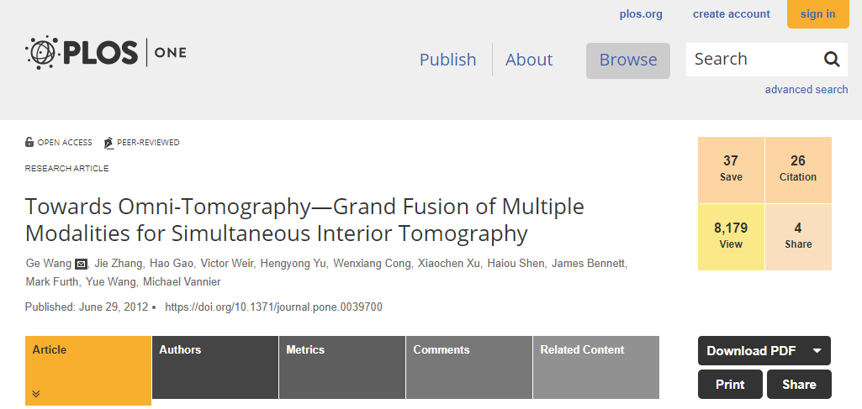
Omni-tomography All-in-One, All-at-Once, All-of-Couplings

Slide 42
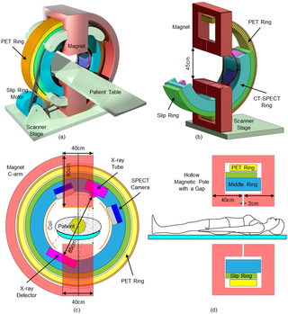

Slide 43
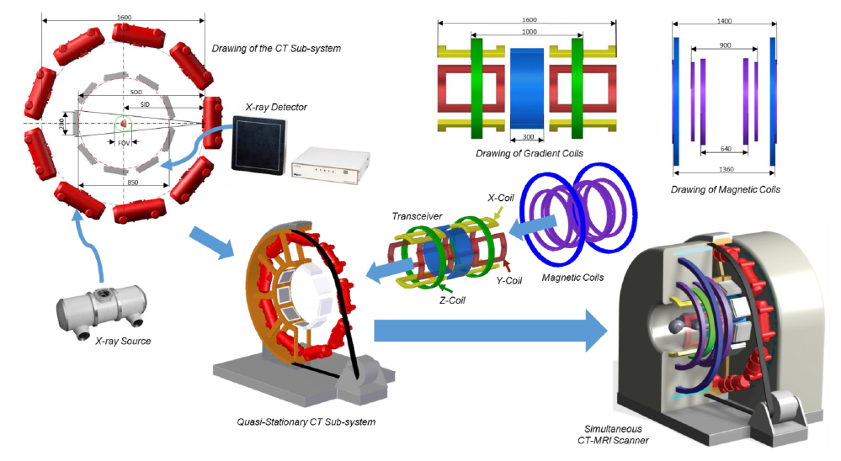

Slide 44
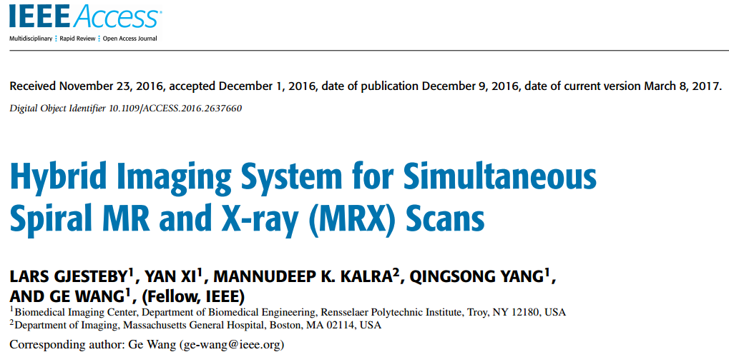
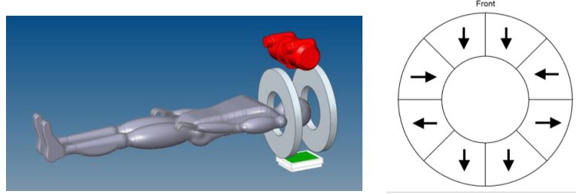

Slide 45
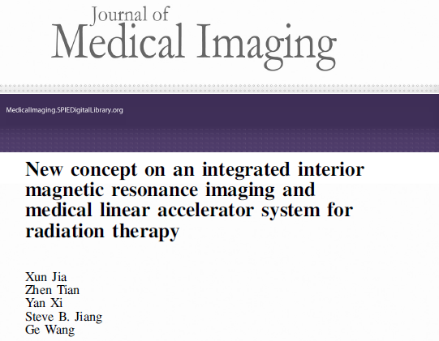
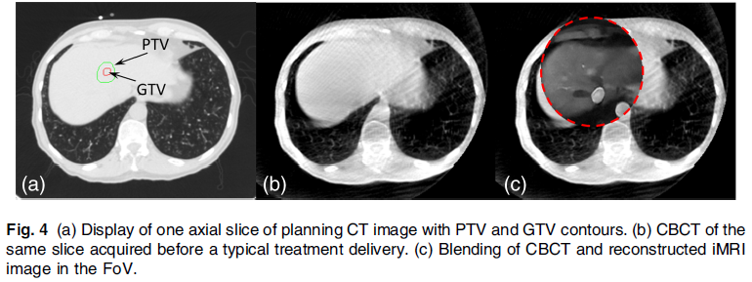

Slide 46
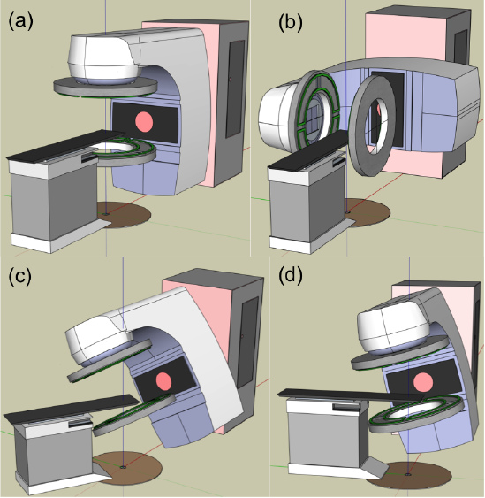
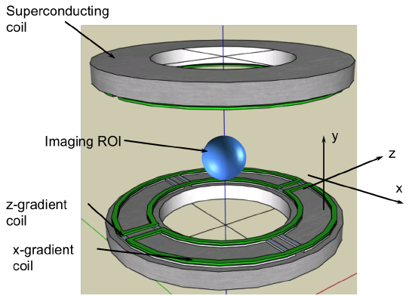

Slide 47
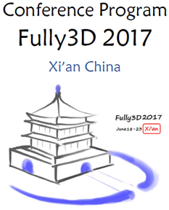
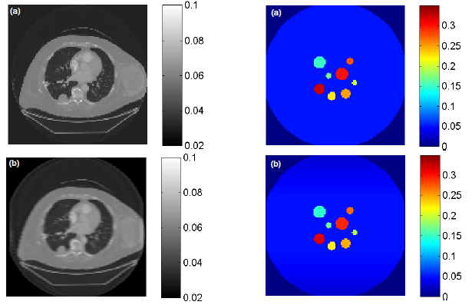

Slide 48
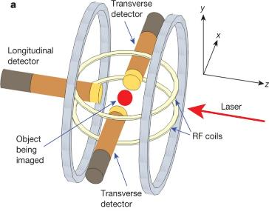
Motivation for SET
Polarized Nuclear Imaging (PNI)
MR Framework
(a) Polar plot of emission probability, (b) 100% polarized nuclei along a main magnetic field, (c) Nuclei oriented in transverse plane rotate about z-axis
Y. Zheng et al. Nature 537.7622: 652-655, 2016
Notes:
-PNI. Reconstruct concentration of Xe131. Imaging setup
-Encode spatial information into atomic spin orientation.
-Polarization to create directionally dependent gamma emission
-Donut, spin freq changes with field strength
-RF pulse flips donut
-Zhong. PNI provides much higher sensitivity than MRI
-Drawback: no attenuation

Slide 49
Existing Polarizable Tracers
Characteristics of some radioisotopes that are the best known candidates for SET at this time. However, these would not be practical for clinical imaging.
Isotope | Half-life | Spin number | γ-ray Emission (keV) | γ-ray Branching Ratio
^{131m}Xe | 12 days | 11/2 | 164 | 2%
^{127m}Xe | 69 sec | 9/2 | 124.8-172.5 | 38%
^{79m}Kr | 50 sec | 7/2 | 130 | 27%

Slide 50
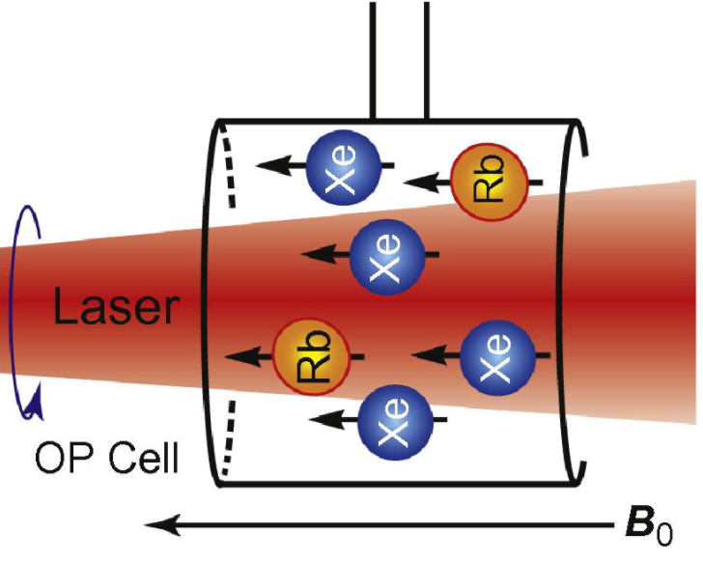
Optical Pumping

Slide 51
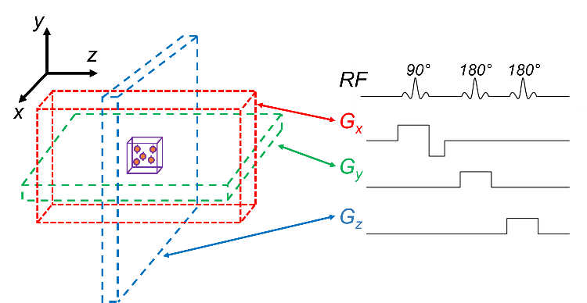
Spin Manipulation

Slide 52
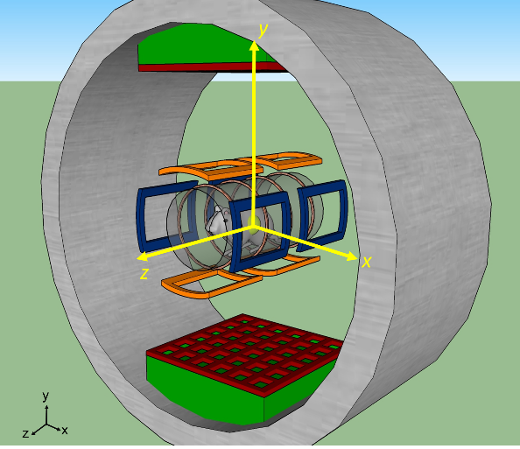
System Concept

Slide 53
SET Data Model
At location r
m₁ and m₂: paired data
Φ: γ-ray flux
µ: attenuation coefficient
Linear integral equation permits inverse solution of
Attenuation coefficients
Flux escaping each side of activated location proportional to concentration

Slide 54
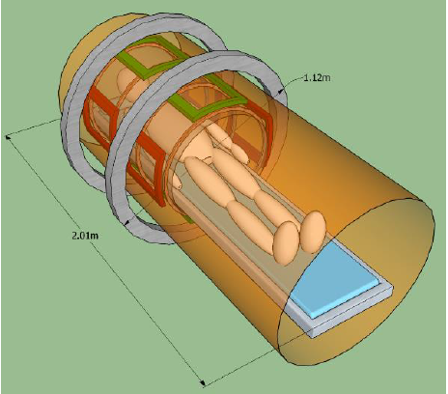
Whole Body Imaging

Slide 55
BB20 Homework
Draw Diagrams for All Pulse Sequences Covered in This Lecture, and Explain the Working Principle for Each of Them.
Due Date: Same (1 Working Week Later)

